Slide 1
The Future of
Clinical Science Training
Keanan Joyner
University of California, Berkeley

Slide 2
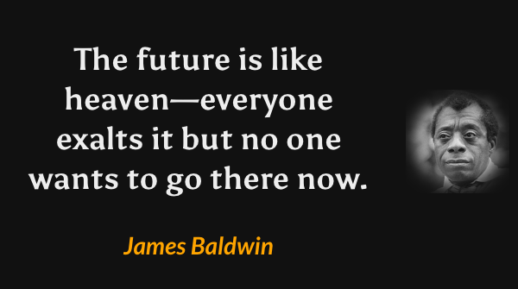

Slide 3

What are our roles as clinical scientists?
“The central goal of clinical psychology is to reduce the suffering caused by mental illness”
“Clinical psychology—a field anchored on the deep integration of basic science and clinical practice—is uniquely positioned to serve as a transdisciplinary hub for this research”
“Too Much Science!” vs. “Too Little Science!”
Core question: How do we address the needs of our nation (and the world) that look to us to relieve the burden of mental illness?
Dylan Gee
Gee, D. G., DeYoung, K. A., McLaughlin, K. A., Tillman, R. M., Barch, D. M., Forbes, E. E., ... & Shackman, A. J. (2022). Training the next generation of clinical psychological scientists: A data-driven call to action. Annual Review of Clinical Psychology, 18, 43-70.

Slide 4
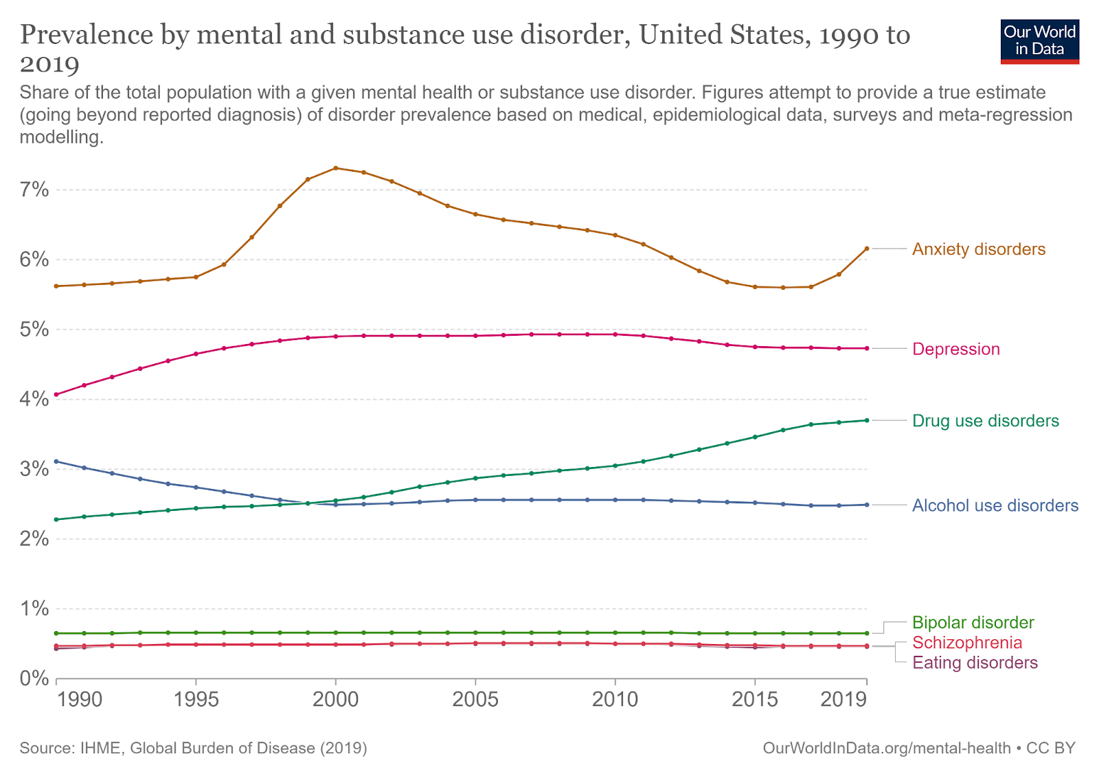
How much do we care?

Slide 5
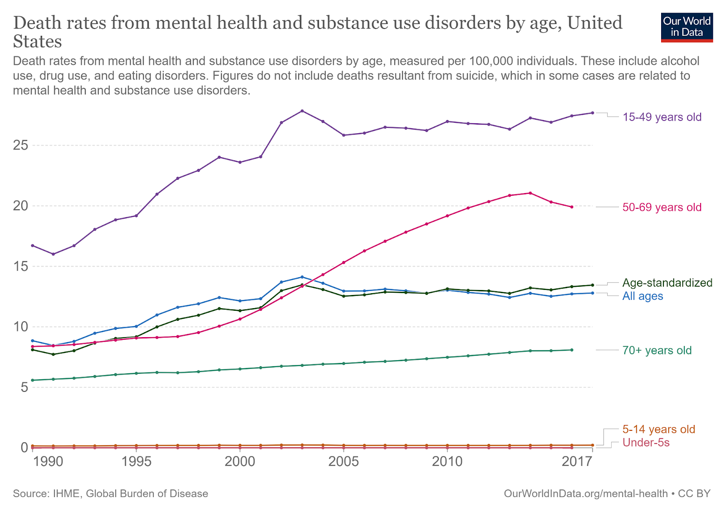
How much do we care?

Slide 6
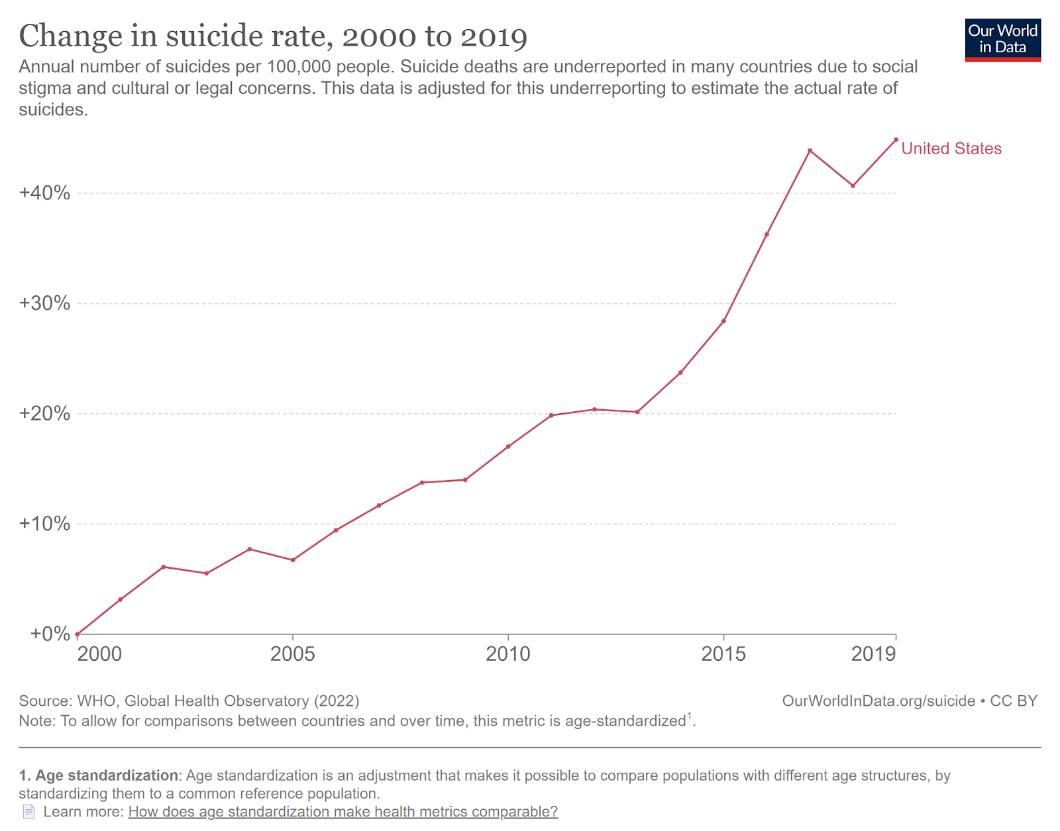
How much do we care?

Slide 7
The Future Is What We Make It

Slide 8
1. The Future is Multidisciplinary
Numerous surveys have been conducted on clinical psychology trainees, and one consistent result has been the extraordinary diversity of training goals
  Varying amounts of clinical practice
  Varying research methods
  Varying settings for work
How do we accommodate such different training goals under the single umbrella of “clinical science”?
  A lot of well-meaning proposals boil down to… “more training” – but where do we add into our curriculums? Where’s the space?

Slide 9
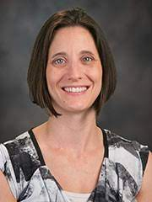
Clinical Training
Less hours in the clinic -> more hours for other things?
  Let’s also not overcorrect
    Integration is key
Minimum competencies for potential practitioners
Therese Kemper

Slide 10
Flexibility in Internship (part 1)
I believe internship is the portion of the training process that is most adaptable to the changing needs of the future
Tail wagging the dog?

Slide 11
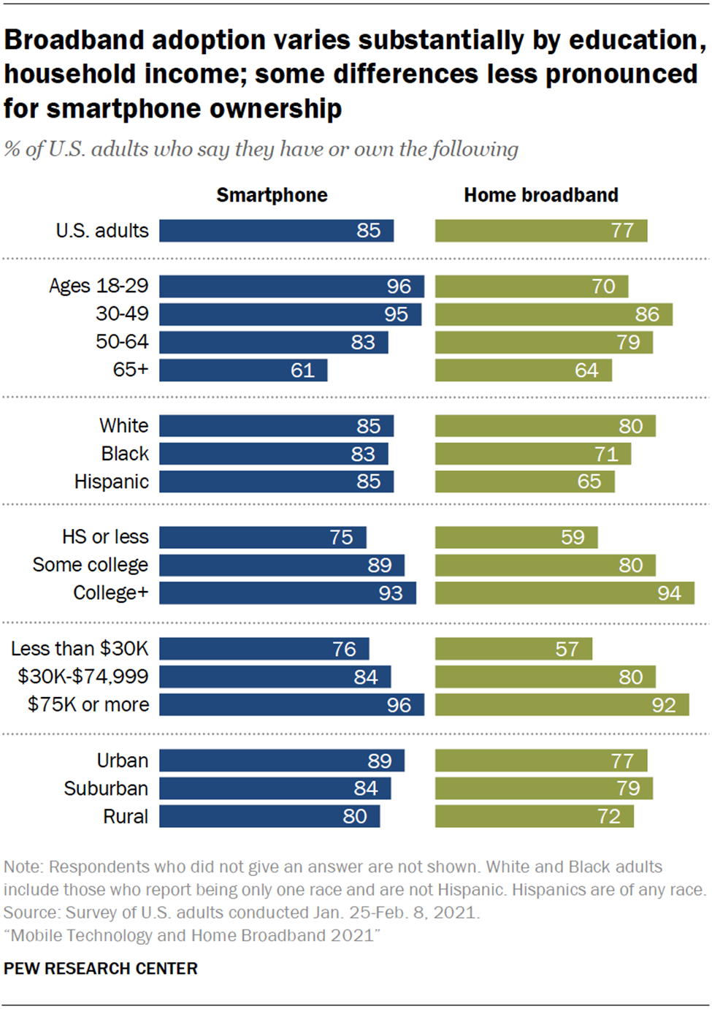
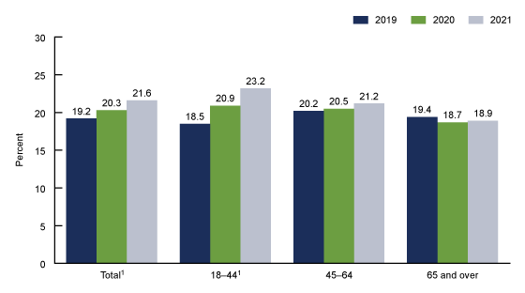
2. The Future is Increasingly Digital
Percentage of adults aged 18 and over who had received any treatment for their mental health in the past 12 months, by age group and year: United States, 2019–2021

Slide 12
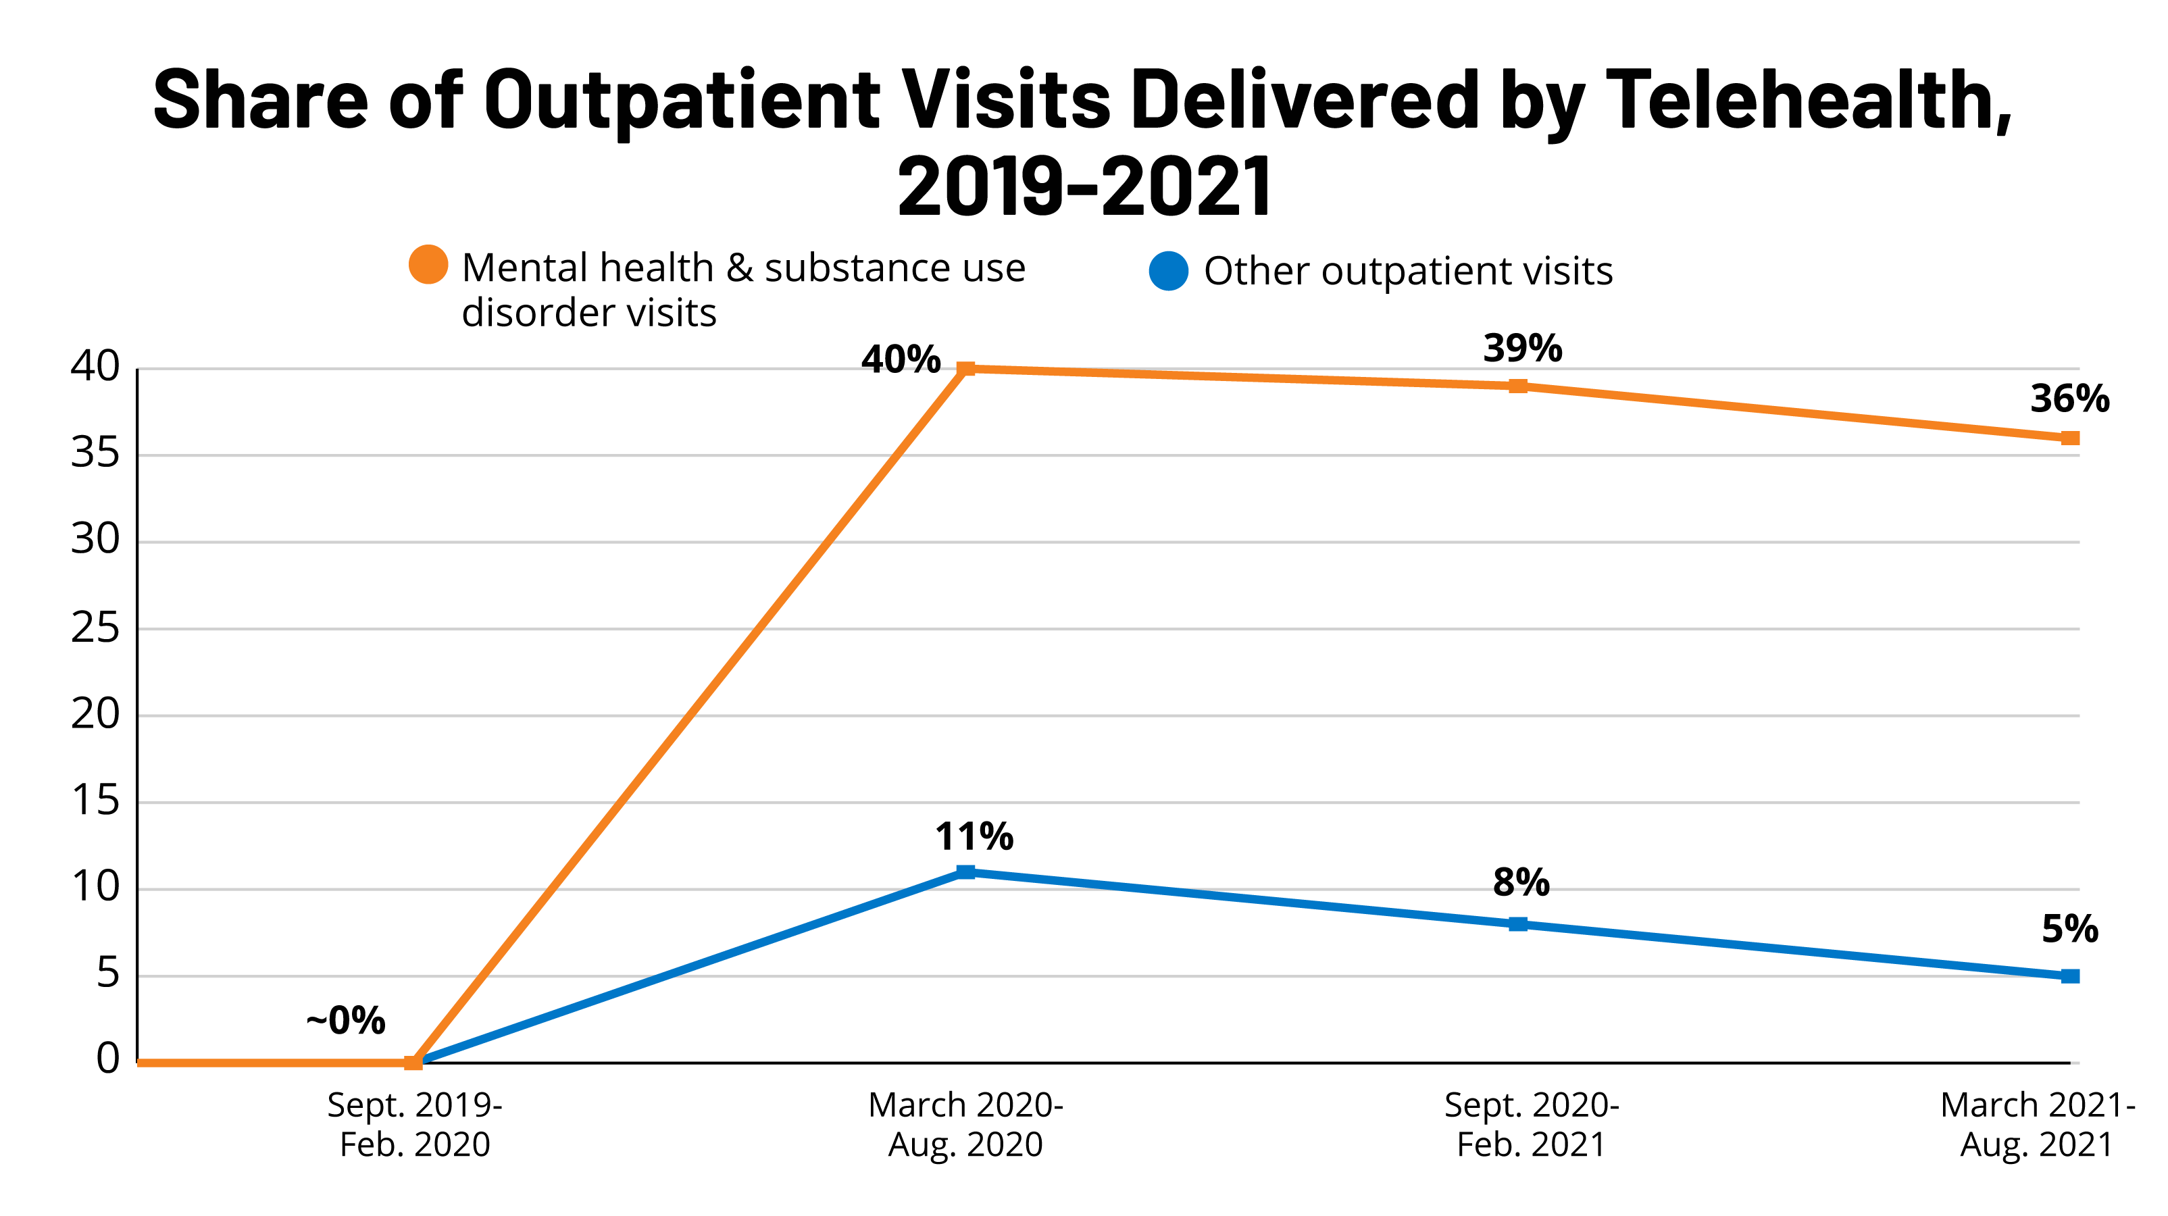

Slide 13
Research Implications
Studies establishing “equivalence” of teletherapy/assessment as in-person work – what happens when the client has spotty wifi? Doesn’t have a private room?
Stepped care models blending digital and traditional intervention elements should increase in priority
Research samples – AI and large language models (LLMs) are advancing fast. We need to quickly establish fieldwide norms about online research, bot detection, and data quality screening

Slide 14
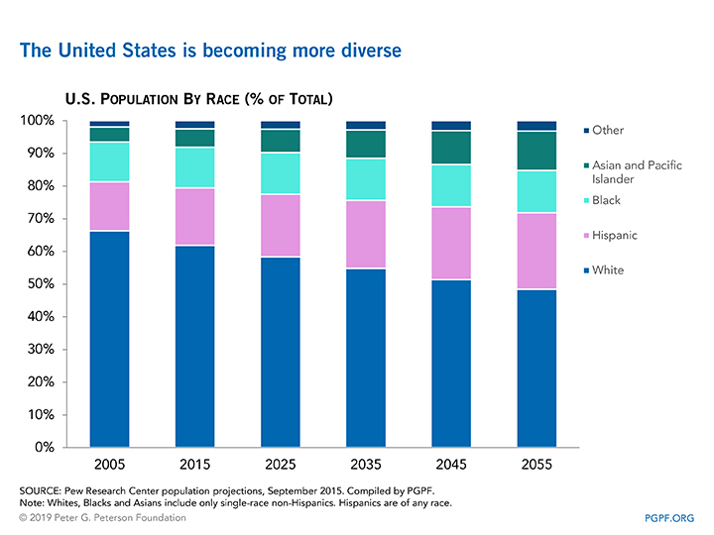
3. The Future is Drastically More Diverse
By 2050, the Census Bureau projects:
  Non-Hispanic Whites will be under 50% of U.S. population
  The proportion of African Americans will have grown by 30+%
  The proportion of Hispanics will have grown by 60+%
  The proportion of Asian Americans will have more than doubled

Slide 15
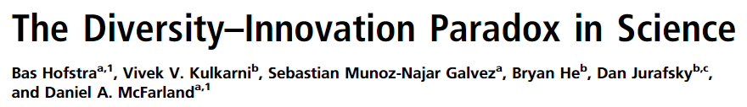
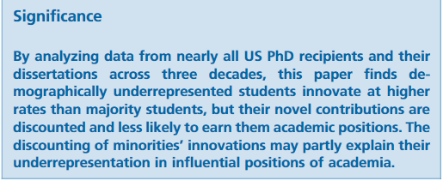
Diversity is Great for Science

Slide 16
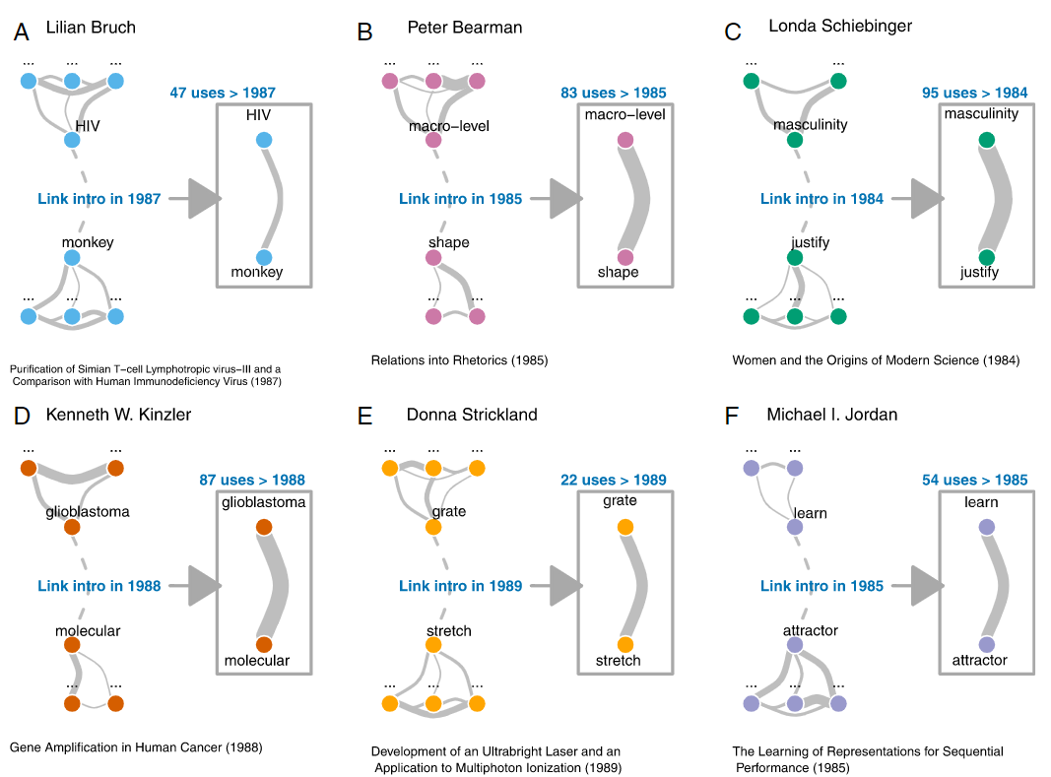

Slide 17
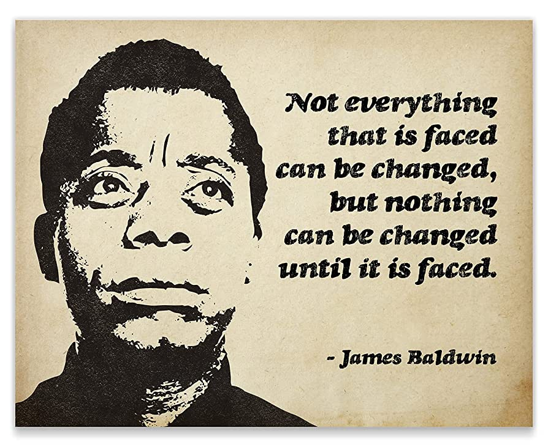
If we don’t measure it, we won’t change it

Slide 18
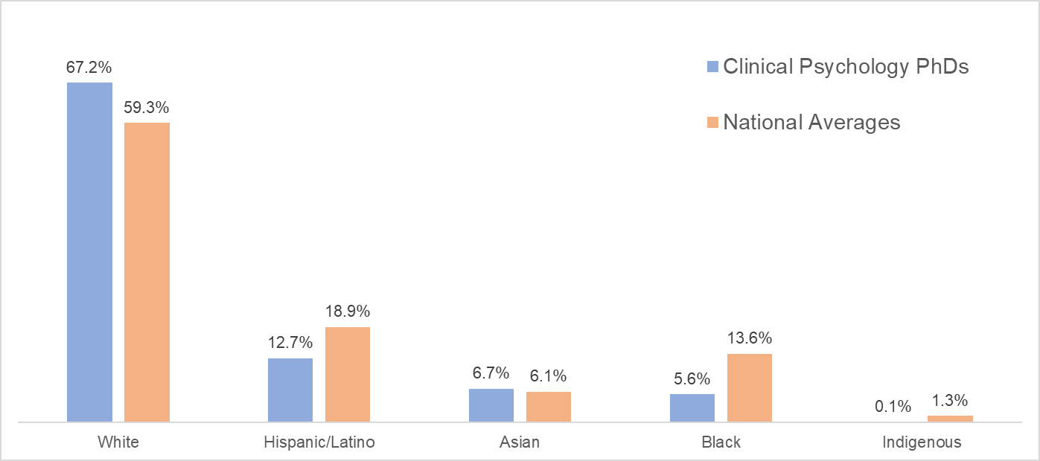
How bad is it?
National Science Foundation, National Center for Science and Engineering Statistics. Doctorate Recipients from U.S. Universities: 2021. Available at https://ncses.nsf.gov/pubs/nsf23300/data-tables
Census data: https://www.census.gov/quickfacts/fact/table/US/PST045222

Slide 19
How bad is it?
Practically, achieving equal representation would involve solving several aspects of structural racism, but I only have like 10 minutes left…
  Low hanging fruit: Prioritize pool utilization

Slide 20
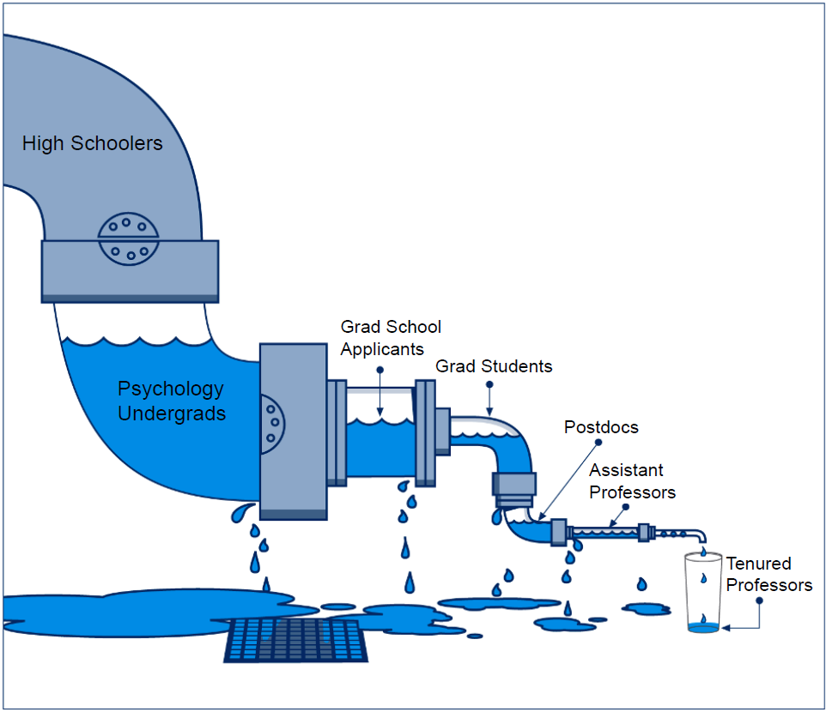
Key Concept: The Leaky Pipeline

Slide 21
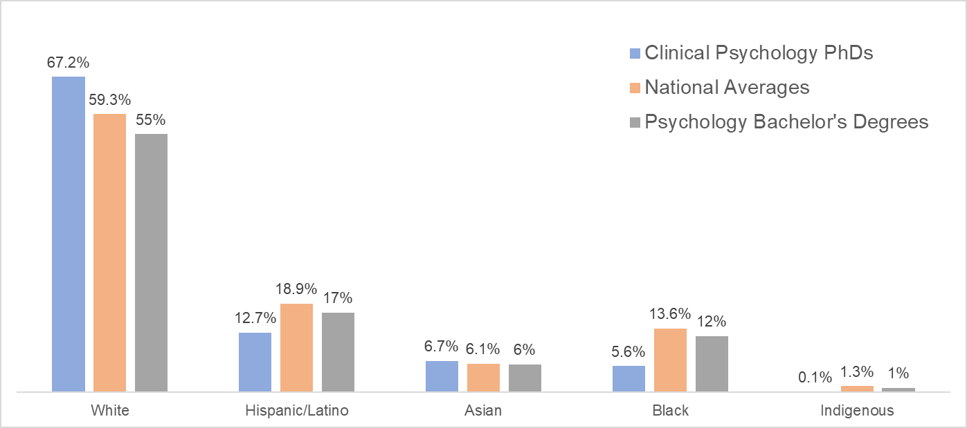
Special Juncture – Undergrad to Grad

Slide 22
Undergrad to Grad School Junctions
Student Interest:
  1) “grad school isn’t for me”
  2) “I can’t afford a PhD”
  3) “I’m not qualified”
Institutional Responsibilities:
  1) what’s our stats on pool utilization?
  2) do we have any strategy for attracting applicants?
  3) are we preparing our undergrad applicants well?

Slide 23
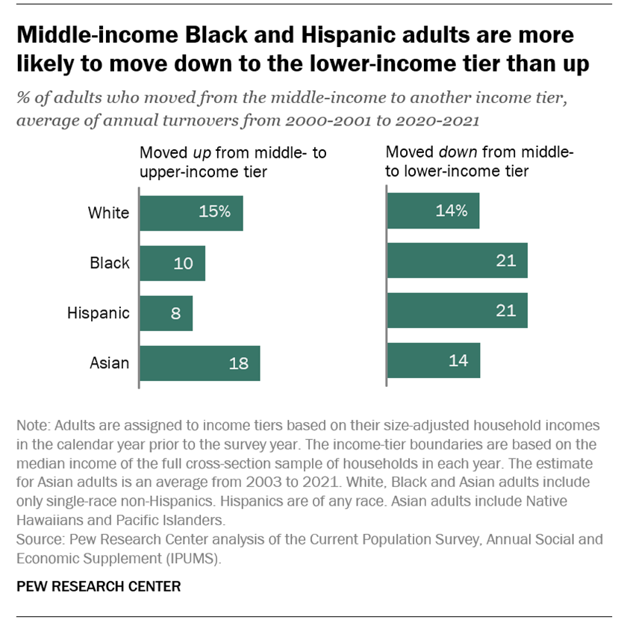
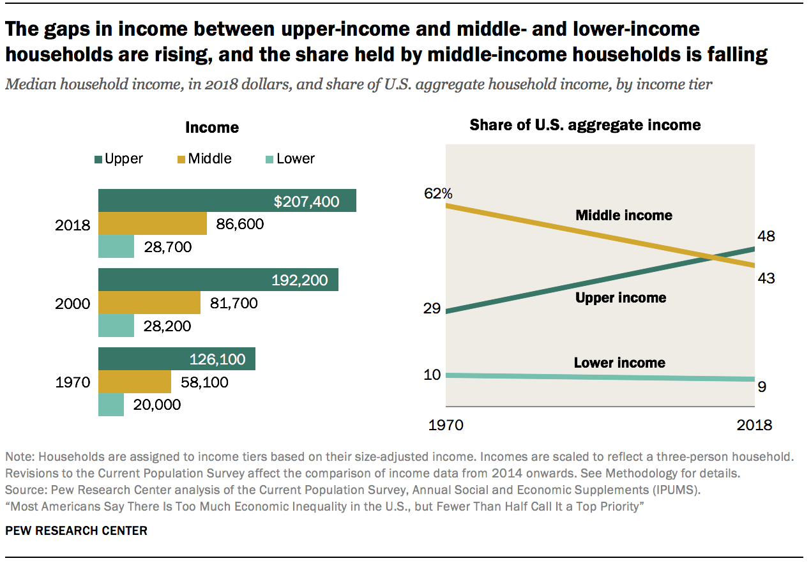
Flexibility in Internship (part 2)

Slide 24
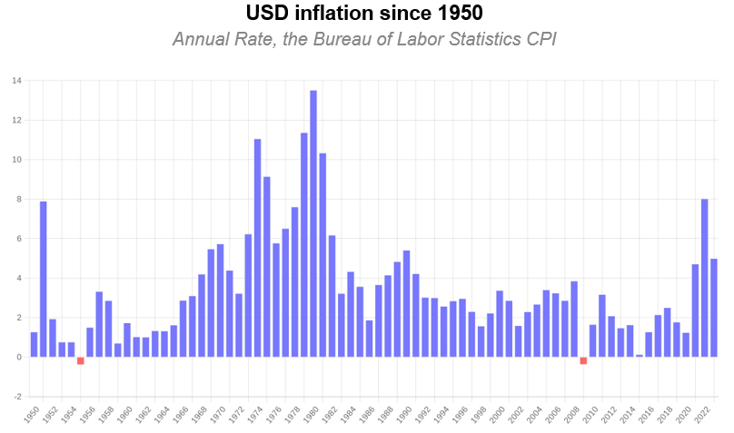
Flexibility in Internship (part 2)

Slide 25
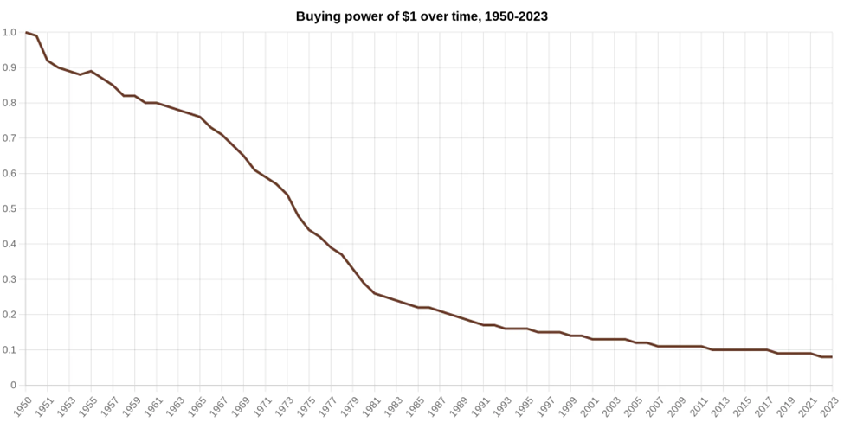
Flexibility in Internship (part 2)

Slide 26
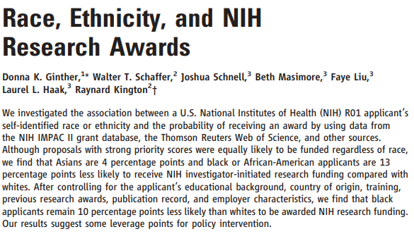
Ginther et al. (2011)

Slide 27
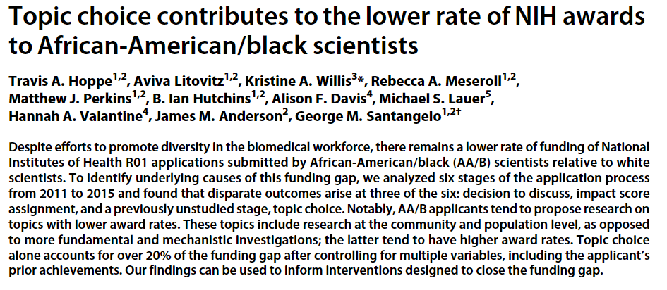
Hoppe et al. (2019)

Slide 28
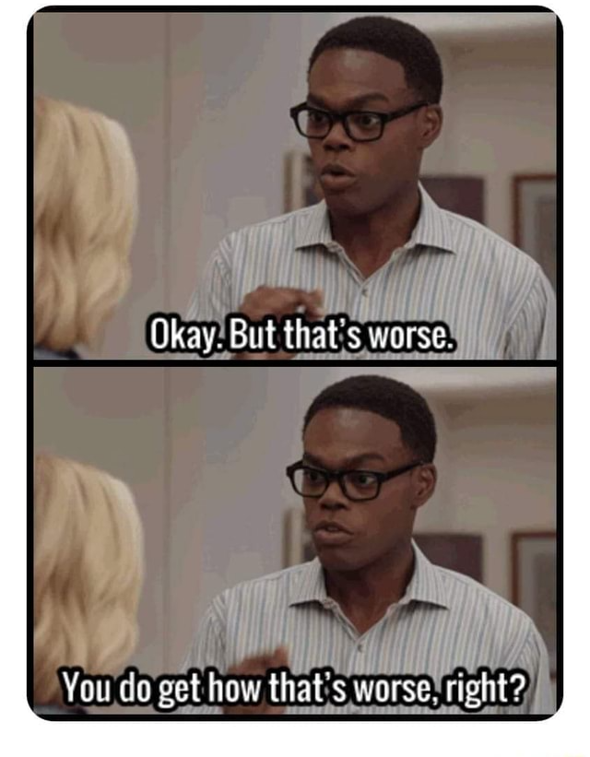

Slide 29
We’ve got some very real challenges ahead – but I believe in our community. Do you?

Slide 30
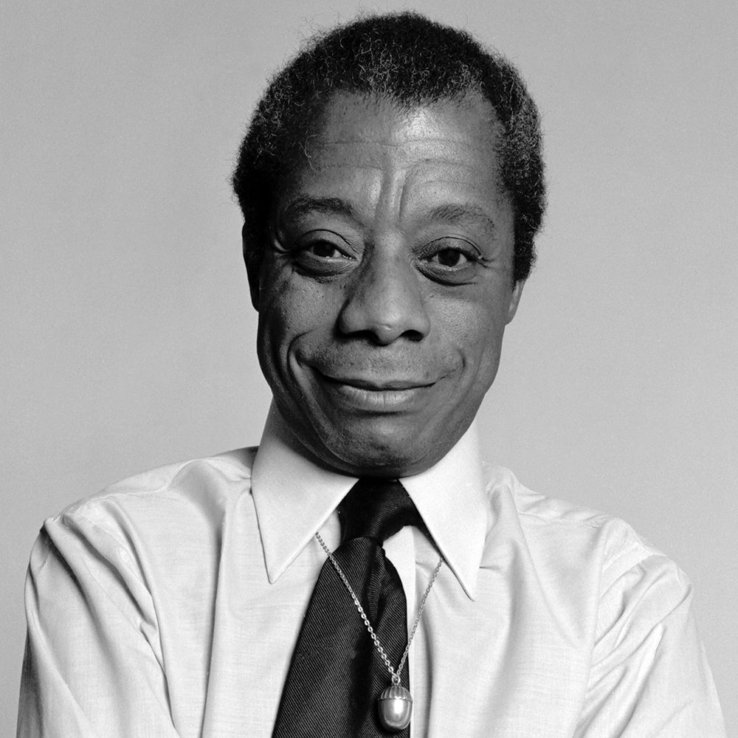
“There is never a time in the future in which we will work out our salvation. The challenge is in the moment, the time is always now.”
- James Baldwin

Slide 31
The Future Is What We Make It

