Slide 1
Psychological Clinical Science Past, Present & Future
Richard M. McFall
Indiana University & Executive Director
Psychological Clinical Science Accreditation System (PCSAS)
APS Convention, NYC, May 22, 2015
Notes:
Thanks for this invitation to talk about Psychological Clinical Science: Past, Present, and Future.

Slide 2
May 22, 2015 New York, NY
A Very Fitting Time and Place
To Reflect on the Evolution of
Psychological Clinical Science
Notes:
May 22nd, 2015 in New York, NY, is a very fitting time and place to reflect on the evolution of Psychological Clinical Science.

Slide 3
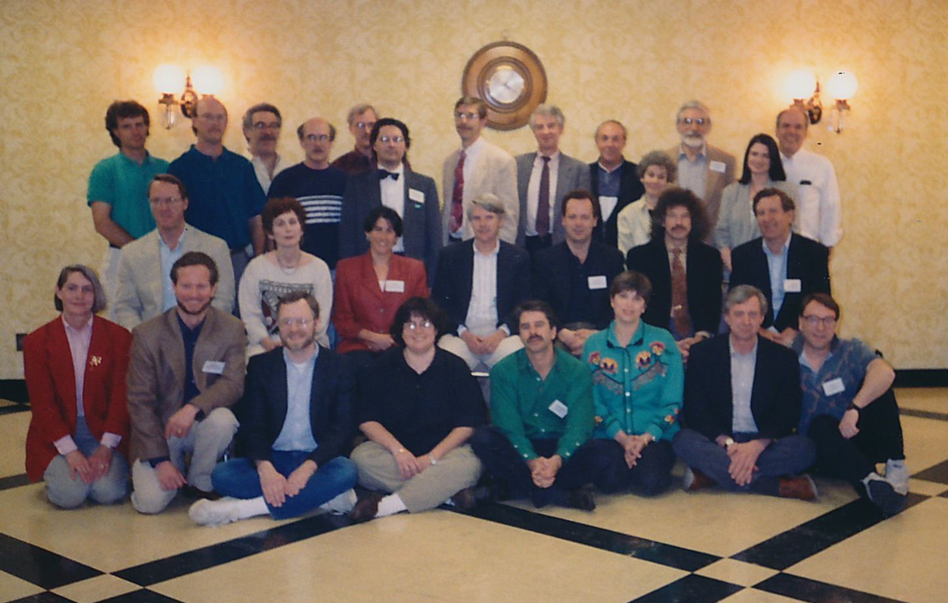
1994 Conference. “Clinical Science in The 21st Century”
Notes:
In 1994, Indiana University hosted a conference in Bloomington on “Clinical Science in the 21st Century,” with support from I.U., APS, and NIMH. The conference resulted in the founding of the Academy of Psychological Clinical Science the following year.
The invited participants at the conference, shown in this photo, were:
Front Row: Susan O’Leary, Mark Whisman, Greg Miller, Ana Marie Cauce, Michael Telch, Jane Steinberg, Ian Evans, Alan Kraut.
Middle Seated: Alan Lang, Judy Conger, Beth Meyerowitz, Bill Ray, Rob DeRubeis, Bob Levenson, Dick Bootzin.
Back Row: Scott Monroe, Blaine Ditto, Ken Sher, Bob Simons Steve Beck, Will Grove, Tim Baker, Don Fowles, Neil Schneiderman, Susan Campbell,, Ken Heller, Laura Carstensen, Dick McFall.

Slide 4
1995: Birth of the Academy of Psychological Clinical Science (APCS)
Celebrating its 20th Anniversary
Notes:
So today we are celebrating the 20th Anniversary of the birth of the Academy (APCS), which held its first meeting here in NYC in association with the annual APS convention.

Slide 5
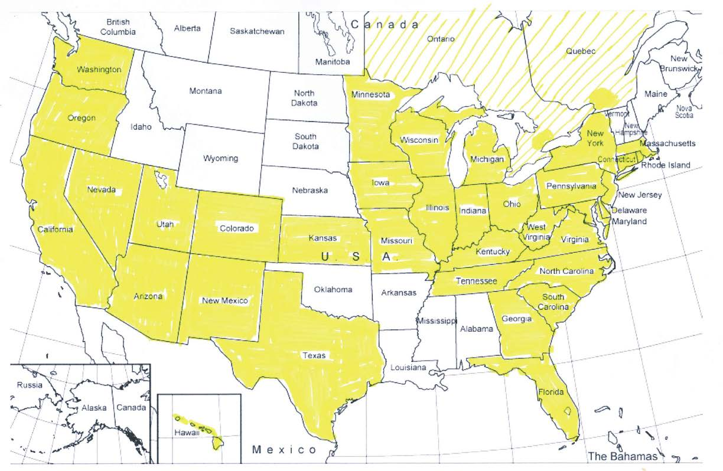
73 APCS Members in 34 States & 2 Provinces: 62 PhD Programs & 11 Internship Programs
Notes:
Over the 20 years, the Academy has grown to have 73 member—62 PhD programs and 11 internship programs—in 34 states and 2 provinces, as shown on this map. As you can see, it is a broad based organization.

Slide 6
Academy of Psychological Clinical Science
APCS Mission:
…to advance “clinical science,” …. a psychological science directed at the promotion of adaptive functioning;…
at the assessment, understanding, amelioration, and prevention of human problems in behavior, affect, cognition or health;…
and at the application of knowledge in ways consistent with scientific evidence.
The Academy’s emphasis on “science” underscores its commitment to empirical approaches to evaluating the validity and utility of testable hypotheses and to advancing knowledge by this method.
1
^{s} Century”
Notes:
The Academy’s mission is… (read from slide).

Slide 7
To Learn More about “the Academy” www.acadpsychclinicalscience.org
History & Mission
Member Programs
Links to Publications
History of the Academy of Psychological Clinical Science. (Fowles)
Clinical Science Model. (McFall, Treat, & Simons)
Psychological Clinical Science Accreditation System. (Bootzin & Treat)
All chapters from: (2015) Encylopedia of Clinical Psychology
Edited by Robin Cautin & Scott Lilienfeld.
Notes:
I encourage you to go to the Academy’s website to learn more about the Academy—its history and mission, member programs, and links to publications. Included are three chapters from the recently published Encyclopedia of Clinical Psychology (Edited by RobinCautin & Scott Lilienfeld, 2015): the history of the Academy, by Don Fowles; an explanation of the Clinical Science Model, by Teresa Treat, Bob Simons, and myself; and the history of the Psychological Clinical Science Accreditation System, by Dick Bootzin and Teresa Treat.

Slide 8
Coincidently, 2015 also marks the 70th Anniversary of the Birth Clinical Psychology* *As we know it today.
Born in 1945, at End of WWII.
Notes:
Read slide.

Slide 9
Importance of understanding the 70-year History of Clinical Psychology
“How did we get here?”
“Why are we doing things this way?”
Notes:
Slide content.

Slide 10
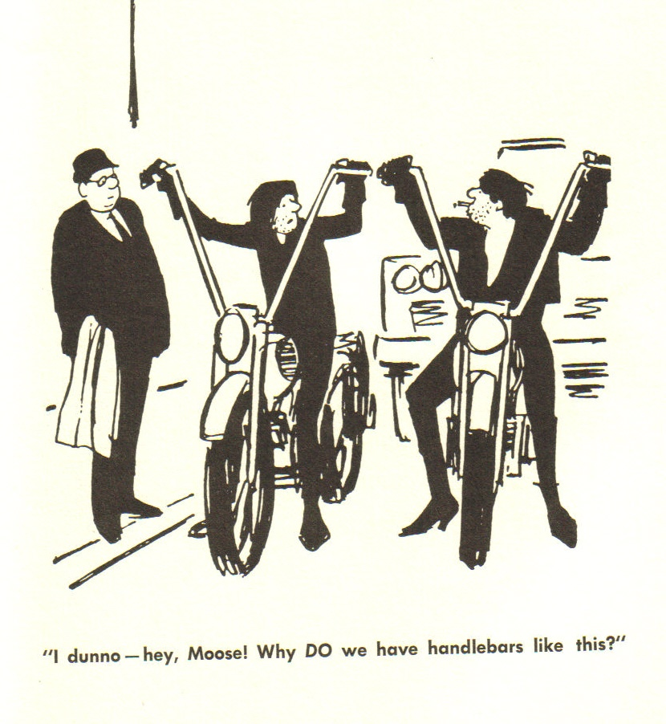
Notes:
Slide content.

Slide 11
???
Challenge the status quo:
“Does this make sense?”
“Is there a better way?”
“What does the evidence tell us to do?”
Notes:
Slide content.

Slide 12
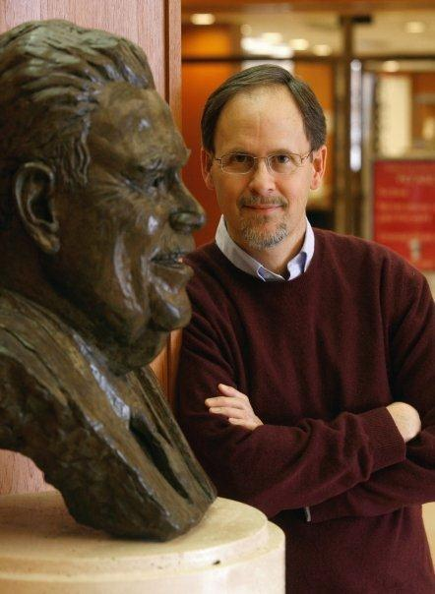
. 1999). Psychologists on the march: Science, practice, and professional identity in America, 1929-1969. New York: Cambridge University Press
James H. Capshew, Ph.D.
History & Philosophy of Science
Indiana University
General History of Psychology
Capshew, J.H. (1999). Psychologists on the march: Science, practice, and professional identity in America, 1229-1969. New York: Cambridge University Press.
Notes:
Key resource for history of psychology.

Slide 13
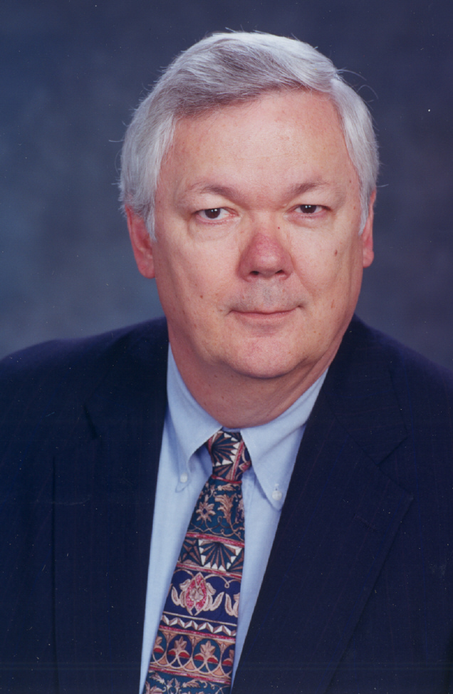
Ludy T. Benjamin, Jr.,Ph.D.
Department of Psychology
Texas A&M University
History of Clinical Psychology
Benjamin, L.T., Jr. (2005). A history of clinical psychology as a profession in America (and a glimpse at its future), Annual Review of Clinical Psychology, 1, 1-30.
Notes:
Key resource for history of clinical psychology.

Slide 14
My Personal Involvement in Clinical Science over 50+ yrs
Notes:
Slide content.

Slide 15
Manifesto for a science of clinical psychology. McFall (1991). The Clinical Psychologist, 44, 75-88.
Cardinal Principle: Scientific Clinical Psychology is the Only Legitimate and Acceptable form of Clinical Psychology
First Corollary: Psychological services should not be administered to the public (except under strict experimental control) until they have satisfied these four minimal criteria:
1. The exact nature of the service must be described clearly
2. The claimed benefits of the service must be stated explicitly
3. These claimed benefits must be validated scientifically
4. Possible negative side effects that might outweigh any benefits must be ruled out empirically.
Second Corollary: The primary and overriding objective of doctoral training programs in clinical psychology must be to produce the most competent clinical scientists possible.
Notes:
My most widely cited paper, based on my presidential address to SSCP in 1990. It was influenced by a paper published in 1972 by one of my mentors, Julian B. Rotter. Little had changed since he wrote his paper. I thought the points I made were simple and straightforward, but the paper caused a stir. I still believe the points are relevant.

Slide 16
Notes:
Some have accused me of tilting at windmills, like a “Don Quixote,”…

Slide 17
A Morality Play!
Notes:
…but I see it as a moral play. We owe it to the public to build clinical psychology on solid scientific foundations, and to make claims and provide services that are honest, tested, valid, and cost-effective .

Slide 18
Clinical Psychology: Applied Science
Intervening in other people’s lives carries serious moral and ethical obligations.
Decisions simply cannot be based on personal “tastes,” professional “traditions.”
Should be true to the best science available.
Notes:
Slide content.

Slide 19
Integrity & Quality Control
Clinical Psychologists cannot justify marketing unproven or invalid services simply by pointing to the obvious need and demand for such services any more than they could justify selling snake oil remedies by pointing to the prevalence of diseses and consumer demand for services.
Good intentions are not enough; unproven interventions are as likely to do harm as help.
Notes:
Slide content.

Slide 20
Clinical Science: an Applied, Humanitarian, Ethical Enterprise
5 MORAL IMPERATIVES
First, do no harm.
Second, give priority to the public’s welfare over all other competing interests (e.g., guild, personal).
Third, strive to ensure access to, and safe and reliable delivery of, the most cost-effective mental and behavioral health care.
Fourth, as a public trust, act ethically—with transparency & integrity—intervening in lives only with full, informed consent.
Fifth, adhere faithfully to a Scientific Epistemology to advance knowledge and improve human well-being!
The public’s welfare is the ultimate reason for Clinical Science.
Notes:
Slide content.

Slide 21
Clinical Science is for Public Healh
Nearly 50% of Americans will be diagnosed with a mental illness.
Over 33 million Americans seek help for Mental Health, Behavioral Health, or Substance Use problems each year.
Over 70% of them receive inappropriate care—i.e., not the best, most effective care (Institutes of Medicine, 2006). Example: OCD treatment in DC.
There is a 13-17 year lag in the transfer of scientific advances to clinical applications (Bauer, 2002). And, too many scientific advances never get transferred.
Improving access to cost-effective Mental & Behavioral Care, backed by the best science, is our essential task.
Notes:
Slide content.

Slide 22
Questions, on these 20th & 70th Anniversaries:
“How has scientific clinical psychology
progressed over these 70 years?” and
“What is the future of Clinical Science?”
Notes:
Slide content.

Slide 23
A Quick History
No “Psychology” until late 1880s
“Mental” practitioners by other names:
phrenologists, graphologists, mesmerists, spiritualists, seers, psychics, mediums, shamans, snake oil sellers, etc.
Physicians treated insanity, typically in asylums
There were no effective treatments.
In fact, treatments tended to be iatrogenic.
Notes:
Slide content.

Slide 24
1892-1945 (To end of WWII)
1892: American Psychological Association founded
APA Bylaws excluded “practice” from mission statement
Two APA classes: “members” (fellows); “associates” (no vote)
Clinical: Child guidance, testing, & consulting (e.g., Witmer)
1917-19: American Assoc. of Clinical Psychologists (Div. 12)
1918: Proposed PsyD, “clinical” as an applied profession; failed.
1921: Div. 12 started “certification” program. No interest.
1937: American Association for Applied Psychology (AAAP)
1944-45: “Patriotic” merger of APA-AAAP (apogee of unity)
Professional Psych largely unsuccessful before WWII.
NO PhD degrees awarded in “clinical” psychology (all OJT).
NO Effective Treatments for Mental Disorders
Notes:
Slide content.

Slide 25
1945: Birth of Clinical Psych
Post-War: Psychologists as “junior psychiatrists?”
1946-47: VA & USPHS Created “Clinical Psychology,” by funding Clinical Psychology Training Programs
1947: APA’s “Shakow Report” on training standards
1947-48: Start of APA accreditation
1949: USPHS funded “Boulder Conference”
(70 participants;2 weeks)
Notes:
Slide content elaborated.

Slide 26
Boulder Model
A compromise, reflecting “schism” between “scientist” and “practitioner” visions
Structure built on oversold promises?
Model was a promissory note for a future ideal:
“clinical science” integrating science & application.
But this ideal was impossible in 1949.
There was no good research on the “science” side,
so, the void was filled with lore & speculation.
Result: a One Dimensional Model
Science OR Practice (no integration possible).
Produced “two-headed clinicians” (lab vs. clinic)
.
Notes:
Slide content.

Slide 27
1960s—Clinical Science Emerged!
1960s: Most psychologists were employed in applied jobs.
1957: CARL ROGERS’ proposed studying psychotherapy “The necessary and sufficient conditions for therapeutic personality change.”
1960s: New Era: Research on psychotherapy exploded!
Bandura’s: (1961) Psych Bull vs (1969) book summarizing research (17 pp vs. 300+ pp)
1966: Section III, Div. 12, APA Founded!
1990: Renamed Society for a Science of Clinical Psychology (SSCP)*
*See Oltmanns & Krasner’s (1993) “History” of SSCP in The Clinical Psychologist
The research had Little Impact on Clinical Practice.
One-Dimensional Model (S v P) Firmly Established! Most Clinical Practice still had Little Scientific Validity.
Notes:
Slide elaborated.

Slide 28
Other Key Developments in 1960s: Drugs & Deinstitutionalization
Drugs began to replace talk Rx!
1955—”Miltown”
1959—Tricyclics
1960—Librium
1963—Valium
Only in Late 1980s—SSRIs
Cost Less; Faster; Testable Effects; Profitable
Florida Courts: “Can’t institutionalize non-dangerous mental patients against their will.”
1964 - Mental Health Centers Act (“Build CMHCs; worry about how to treat the clients later.”)
Notes:
Slide elaborated.

Slide 29
1970-80s: Boulder Model Unraveled?
Explosive growth of Clinical Psychology
Scientists pushed for Evidence-Based Practice & Accountability
e.g., Section III, Div. 12, of APA: “Empirically Supported Treatments”
Practitioners Rejoinder: “Clinical Experience trumps Research”
1970s: Birth of “Scholar-Practitioner Model” (PsyD—practice only) and Rapid Emergence of “For Profit” PsyD Training Programs.
By 1984, supply > demand (for jobs & internships); workforce!!
VA and NIMH stop funding clinical training programs; need is met.
Practitioners were winning the “Numbers Game” at APA.
1945 “Schism” became public; not a happy family.
FIGHT FOR PROFESSIONAL IDENTITY; LIVELYHOOD; SURVIVAL
(Beginning of campaign to give psychologists Rx privileges.)
Notes:
Slide.

Slide 30
1988-2015: Psychological Science
1988: APS founded, reclaiming “psychological science”
1992: Chicago Summit on Accreditation (APS, NIMH, COGDOP)
1992-1994: Alternative Accreditation System drafted
1994: Conference on “Clinical Science in 21st Century”
1995: Academy of Psychological Clinical Science (APCS); Birth of the “Clinical Science Model” of training
1995: CoA revised criteria, promised new flexibility. Still dissatisfaction with CoA’s support of “clinical science” model.
2005: Snowbird Summit. “Clinical Science Model” within CoA?
2006: APA rejected the Snowbird Proposal.
Efforts to promote the clinical science model within CoA failed!
Notes:
Slide.

Slide 31
2007: Academy Launched Accreditation: “Psychological Clinical Science Accreditation System”
2009: Started accrediting PhD programs
2012: CHEA (Council for Higher Education Accreditation)
2014: Delaware & Illinois pass licensing laws
2013-15: Campaign expanded to other states
2015: Office of Veterans Affairs revising regulations to recognize PCSAS for internships and staff positions.
Notes:
Slide.

Slide 32
May 20, 2015 28 PCSAS Accredited Clinical Science Programs
University of Arizona University of Minnesota
Arizona State University University of Missouri
University of California, Berkeley Northwestern University (Psych)
University of California, Los Angeles Ohio State University
University of Delaware University of Oregon
Duke University University of Pennsylvania
Emory University University of Pittsburgh
University of Georgia University of South Florida
Harvard University University of Southern California
Indiana University Stony Brook University
University of Illinois—U/C University of Virginia
University of Iowa Virginia Tech University
University of Kentucky Washington University St. Louis
McGill University University of Wisconsin
Notes:
Slide. Note: as of May 2015, there were 29 accredited programs, with the addition of Temple University’s PhD program in psychological clinical science. More programs are in the process of applying.

Slide 33
THE PRESENT Question: Why Academy & PCSAS?
“The Current State of Confusion Requires Clarity & Differentiation”
“Advance Scientific Knowledge and Translate to Increase Well-Being”
Notes:
Slide

Slide 34
“Clinical Psychologist” Ambiguous & Confusing Label
Three models, with same name, but quite heterogeneous:
Different Visions, Philosophies, Aims & Outcomes
Boulder Model (since 1947s): “Scientist-Practitioners” trained for both research and practice (most practice).
Psy.D. Model (since 1960s; NCSPP 1976): “Practitioner-Scholars” trained only practice (not as researchers or scientists).
Clinical Science Model (since 1995; APCS): “Clinical Scientists” trained as research scientists focused on clinical problems in mental and behavioral health: origins; assessment; prevention; and treatment. Emphasis on integrative, translational science. Fully qualified to act as independent providers of clinical services, but only if the science indicates that this is most cost-effective choice. Advance knowledge, promote top health care.
Notes:
Slide

Slide 35
APA/CoA Accreditation
Notes:
Slide

Slide 36
APA/CoA Accreditation
Notes:
Slide

Slide 37
Clinical Accreditation by CoA
Notes:
Slide

Slide 38
Clinical Doctoral Students
Notes:
Slide

Slide 39
Students Per Program (2014)
Notes:
Slide

Slide 40
Independent PsyD Programs vs. University PhD Programs
PROXY DATA: Not all PsyD alike; not all PhD alike!
Selectivity: (Mean acceptance rates)
PsyD 50% (up to 80%) vs. PhD only 11%
Mean Class Size: PsyD = 48; PhD = 9
Student-Faculty Ratio: PsyD nearly double
GREs & GPAs: PsyD students lower on both
Full-time Faculty: Lower in PsyD programs.
Financial Support: Lower in PsyD programs
Cost: Higher in PsyD programs
Grad Debt Over $75k: 24% vs. 5% research programs
Licensing Exam Mean Scores: PsyD grads lower
Notes:
Slide

Slide 41
Quality of “Academy” PhD Programs
USNews Rankings: 24 of top 25 programs
EPPP Exam Scores: 96+% pass
Internship “match” placements: 97+%
Is Academy “Elitist?”: Membership is open & aspirational, serving as a “magnet” to promote excellent clinical science training.
Not an accreditation system
Notes:
Slide

Slide 42
PCSAS Accreditation: Criteria
Solid Foundation in Clinical Psychology: Assessment, Intervention, Psychopathology, and Quantitative Methods
Rigorous Training in Research Skills, Critical Thinking, and Scientific Epistemology
Breadth: Not just psychology, also allied areas (e.g., neuro., genetics, cognitive, devel., social) that enhance research advances on problems
Innovation and Flexibility encouraged, beyond these.
Clinical Competence in Empirically Supported Clinical Assessment, Intervention, Prevention
EVALUATIONS based on documented OUTCOME DATA from past 10 years; not on checklists or matches to INPUTS! Qualitative evaluations looking for excellence.
Notes:
Slide

Slide 43
Today’s Challenges
Managed Care & Health Care Reform: turmoil?
Changing MH: accountability; cost-effectiveness evidence; more for less.
Changing delivery system & workforce:
— increased pharmacological services; decreased psychosocial services
— over 80% of prescriptions now written by primary care physicians
— 1992: MSWs delivered only 5% MH services; 56% in 1997 (Clay, 1999)
CENTERSTONE COMMUNITY MENTAL HEALTH SYSTEM
1,851 employees: 41 psychologists (2%) and 38 psychiatrists
Reimbursement rates: same for PhDs and non-licensed MSWs
Contract for direct service to serious mental illness: $128 /mo/patient
“RIGHT-SIZE” & “RIGHT-KIND” THE MENTAL HEALTH WORKFORCE
TOO MANY NON-SCIENCE PRACTITIONERS. NEED A PHD/PSYD?
SCIENCE TRAINING IS OUR “VALUE ADDED” KEY TO A FUTURE ROLE
Notes:
Slide. Note: Centerstone CMHC is the largest CMHC in the U.S., with centers in four states. It is recognized as one of the very best CMHC organizations.

Slide 44
College Grads: Income by Area
Notes:
Slide.

Slide 45
Future? Reforming MH Care
Problem: Need a way to differentiate among clinical psychologists. Significant heterogeneity in training, services, roles.
PCSAS Accreditation: “Brand” to highlight distinctions and help the public identify clinical psychologists from high-quality science-centered doctoral programs.
PCSAS Ultimate Goal: Use leverage of accreditation to reform the mental & behavioral health care system, and to enhance clinical psychology’s science-centered contributions to the system.
Notes:
Slide.

Slide 46
Future of Psychological Clinical Science & Mental and Behavioral Health Care?
Credential-based vs. Procedure-based System
Decisions: Services and Delivery System? Science-Based: Cost-effectiveness Criterion!
Clinical Scientists’ Future Roles:
research, teaching, administration, supervision, training, dissemination, program evaluation, treatment development, assessment, policy, consultation, prevention, and…treatment!
Intervene, only when the evidence justifies it!
Notes:
Slide.

Slide 47
Continuing the Evolution of CS
We can’t be satisfied with our achievements!
Knowledge of etiology of such problems?
Ability to assess, diagnose, understand disorders?
Ability to intervene and reduce the problems?
Ability to prevent (decrease likelihood) problems?
System for preparing people to do all of above?
System for protecting the most vulnerable public from the harm of false claims and promises?
Notes:
Slide.

Slide 48
Achieving the 70-year-old Ideal of an INTEGRATED SCIENTIFIC CLINICAL PSYCHOLOGY
Finally Achieve the “IDEAL” of a TWO-Dimensional Model:
1. Science vs. Art (non-science); 2. Basic vs. Applied
Advance scientific knowledge about mental and behavioral health
Translate knowledge into cost-effective health care procedures, without preserving professional prerogatives.
Ensure skilled and faithful delivery of these procedures, without preconceptions about the delivery system.
Ensure the dissemination and availability of these procedures without clinging to the 45 min hour.
Establish a system of accountability and continuous quality improvement for services providers and systems.
Notes:
Slide.

Slide 49
Gateway to this Future?
Top-Quality Doctoral Education & Training in SCIENCE-CENTERED, INTEGRATIVE
CLINICAL PSYCHOLOGY
Notes:
Slide.

Slide 50
Further Readings
McFall (2006). Doctoral training in clinical psychology. Annual Review of Clinical Psychology, 2, 21-49.
Baker, McFall & Shoham (2008). Current status and future prospects of clinical psychology: Toward a scientifically principled approach to mental and behavioral health, Psychological Science in the Public Interest , 9:2, 66-103.
Notes:
Slide.

Slide 51
Congratulations to APCS!

Slide 52
Enlist in the Cause?
If not you, who?
If not now, when?

Slide 53
THANK YOU!

