Slide 1
Equity and Justice in Clinical Science Training
Joanne Davila
Stony Brook University
Stacy Frazier
Florida International University
Jaisal Merchant
Washington University in St. Louis
Notes:
We were asked to introduce the first topic of our Summit, which is “Equity and Justice in Clinical Science Training,” and we’re really happy to be doing so. With our presentation, we’ll speak to the compatibility of an equity and justice approach with the clinical science approach in the hopes that it will spur open and creative and even sea changing discussion, as we think about the future of the clinical science model and implications for training.
After our presentation today, you’ll be asked meet in workgroups that will address each of these four topics:

Slide 2
Equity and Justice in Clinical Science Training
Accountability of clinical science training in “moving the needle” for public health by preparing trainees to meet societal needs
Equitable evaluation of applicants
Promoting health and well-being for clinical science students, faculty, and staff, including addressing burnout
Training from a DEI perspective
Notes:
DON’T READ THEM, just say:
These topics each have their own unique challenges, but we believe they also are related to one another in important ways, and in our talk today, we’ll discuss issues that link them together and that have implications for clinical science.
Now, these four topics were not selected randomly. They were selected because the data suggest that we have not done a good enough job in any of these areas. Let me highlight a few examples.

Slide 3
Accountability of clinical science training in “moving the needle” for public health by preparing trainees to meet societal needs
Notes:
Regarding the first topic - By virtually all indicators (based on lots of data), we have not moved the needle for public health

Slide 4
We’re not moving the needle…
“Nationwide, almost one in five people (47.1 million) in the U.S. are living with a mental health condition.
That number increased by about 1.5 million over last year’s report” (Mental Health America)
“Adolescent Mental Health Continues to Worsen” (CDC)
“From 2000-2020 female suicide rates have more than tripled for those aged 10-14
and have gone up 87% for those aged 15-24” (CDC)
“Prevalence rates for youth psychopathology have steadily increased over the last two decades.
Youth from underserved families (e.g. racial/ethnic minority, rural, poor, gender, and sexual minority)
are disparately impacted…” (Cobb, 2022)
“Rates of suicidal ideation are highest among youth, especially LGBTQ+ youth” (Mental Health America)
“The prevalence of any mental illness was highest among the adults reporting two or more races” (NIMH)
“Overall, 57% of adults with a mental illness receive no treatment and 60% of youth with depression
do not receive any mental health treatment” (Mental Health America)
Notes:
As the examples on this slide indicate, there are – increasing rates of mental health problems, especially among youth; increasing health disparities; inaccessibility of health care - and all of these are increasing among diverse and underserved groups.
______________________________________
Suicide:
https://www.cdc.gov/nchs/products/databriefs/db433.htm
From 2000 through 2020, female suicide rates were consistently lowest among those aged 10–14; however, the rate more than tripled from 2000 (0.6) to 2020 (2.0).
For females aged 15–24, rates were stable between 2000 (3.0) and 2007 (3.1), and then increased 87% through 2020 (5.8).
https://mhanational.org/issues/2023/mental-health-america-prevalence-data
https://mhanational.org/issues/mental-health-america-printed-reports#:~:text=Nationwide%2C%20almost%20one%20in%20five,one%20race%2C%20at%2012%25.
“Nationwide, almost one in five people (47.1 million) in the U.S. are living with a mental health condition. That number increased by about 1.5 million over last year’s report.
About 10% of youth in the U.S have severe depression. This was highest among youth who identify as more than one race, at 12%.
Overall, 57% of adults with a mental illness receive no treatment and 60% of youth with depression do not receive any mental health treatment.
Rates of suicidal ideation are highest among youth, especially LGBTQ+ youth. In September 2020, over half of 11-17-year-olds reported having thoughts of suicide or self-harm more than half or nearly every day of the previous two weeks. From Jan. to Sept. 2020, nearly 78,000 youth reported experiencing frequent suicidal ideation, including nearly 28,000 LGBTQ+ youth.
Between April and Sept., 70% of people reported that loneliness or isolation was the top contributing factor to mental health issues, followed by past trauma (46.1%) and relationship problems (42%).”
https://www.nimh.nih.gov/health/statistics/mental-illness
https://www.cdc.gov/nchs/products/databriefs/db444.htm
https://www.who.int/health-topics/mental-health#tab=tab_1
https://mhanational.org/issues/2022/mental-health-america-access-care-data
CDC:
https://www.cdc.gov/healthyyouth/mental-health/index.htm
Rates on youth, and info about health disparities
https://acamh.onlinelibrary.wiley.com/doi/full/10.1111/jcpp.13703

Slide 5
We’re not moving the needle, despite…
2,919 NIMH awards made in 2022
NIMH funding in 2022 = 1.7 billion dollars
APA, alone, publishes 90 journals
A PsycInfo search of peer-reviewed articles on human subjects,
written in English, and published in 2022-2023 yielded over 90,000 articles
Clinical science isn’t meeting its goals…
Notes:
JUST SAY THIS - That we have not made meaningful differences in moving the needle, despite the many grants written (and taxpayer dollars spent), and the thousands of scientific articles and treatment manuals that are published each year is alarming and clearly tells us that our science is not meeting its goals

Slide 6
Equitable evaluation of applicants
Notes:
Regarding the 2nd topic - Although we don’t have a lot of published data, if we simply look at who has been (and still is) in our graduate training programs, on our faculty, and in leadership positions, it’s abundantly clear that the field continues to lack diversity of many kinds

Slide 7
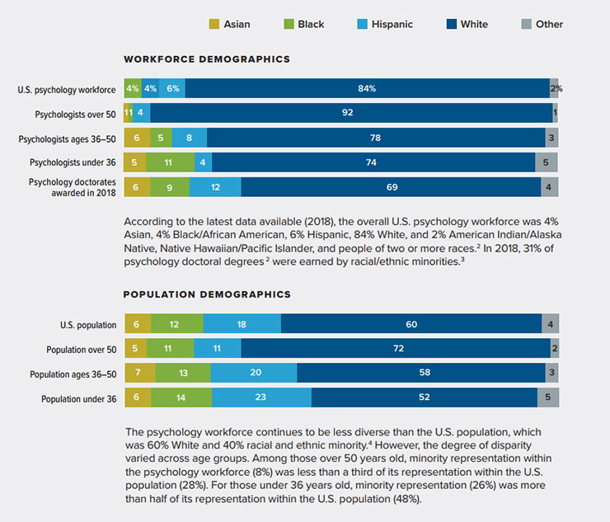
Diversity (or lack thereof) in psychology (2018)
From APA Center for Workforce Studies at cws@apa.org
Notes:
For example, in 2018, 84% of the US psychology workforce were white. This is somewhat less true if we look at younger ages, but the field is still overwhelmingly white.

Slide 8
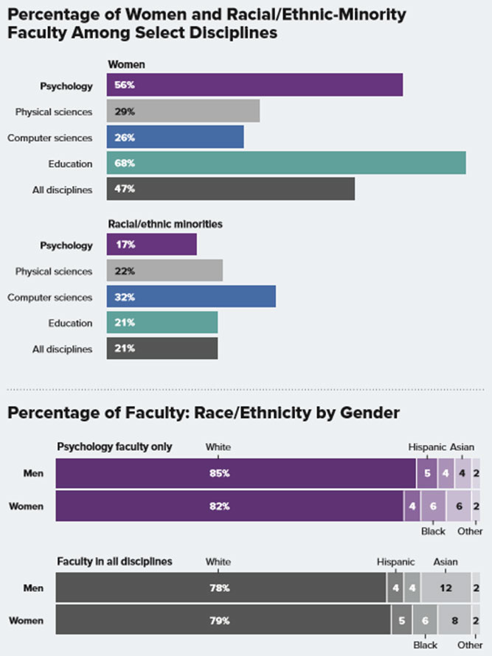
Diversity or (lack thereof) among faculty in psychology (2018)
From APA Center for Workforce Studies at cws@apa.org
Notes:
If we look at psychology faculty in particular, only 17% were racial/ethnic minorities in 2018.
These data suggest that diverse applicants have either not made it to the stage of application, have not been selected, have not made it into clinical science careers, and have not risen to the higher ranks – or all of the above
People have been talking about “pipeline problems” for years, yet the field has not made meaningful changes; again we’re not meeting our goals.

Slide 9
Promoting health and well-being for clinical science students, faculty, and staff, including addressing burnout
Notes:
Regarding the 3rd topic - Rates of mental health problems are high for students and faculty

Slide 10
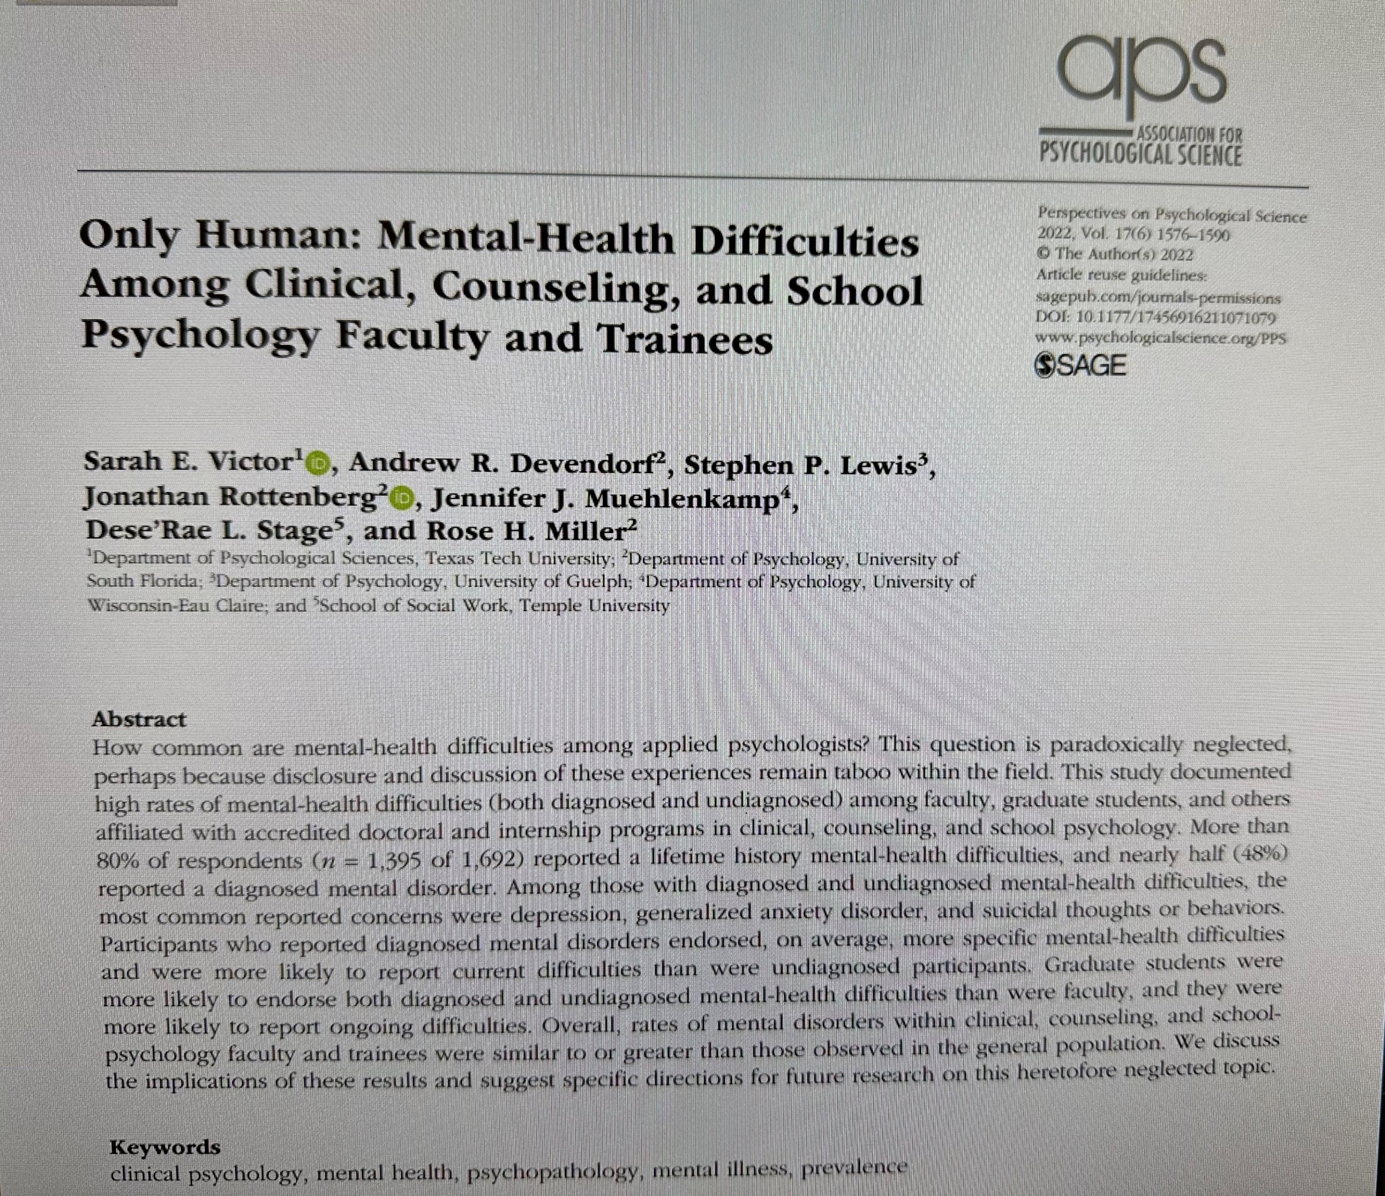
Notes:
In this article by Sarah Victor and colleagues which looked at mental health difficulties among faculty and trainees, they reported that “More than 80% of respondents (n = 1,395 of 1,692) reported a lifetime history mental-health difficulties, and nearly half (48%) reported a diagnosed mental disorder.”
They also reported that “Graduate students more likely to endorse… mental health-related difficulties…”

Slide 11
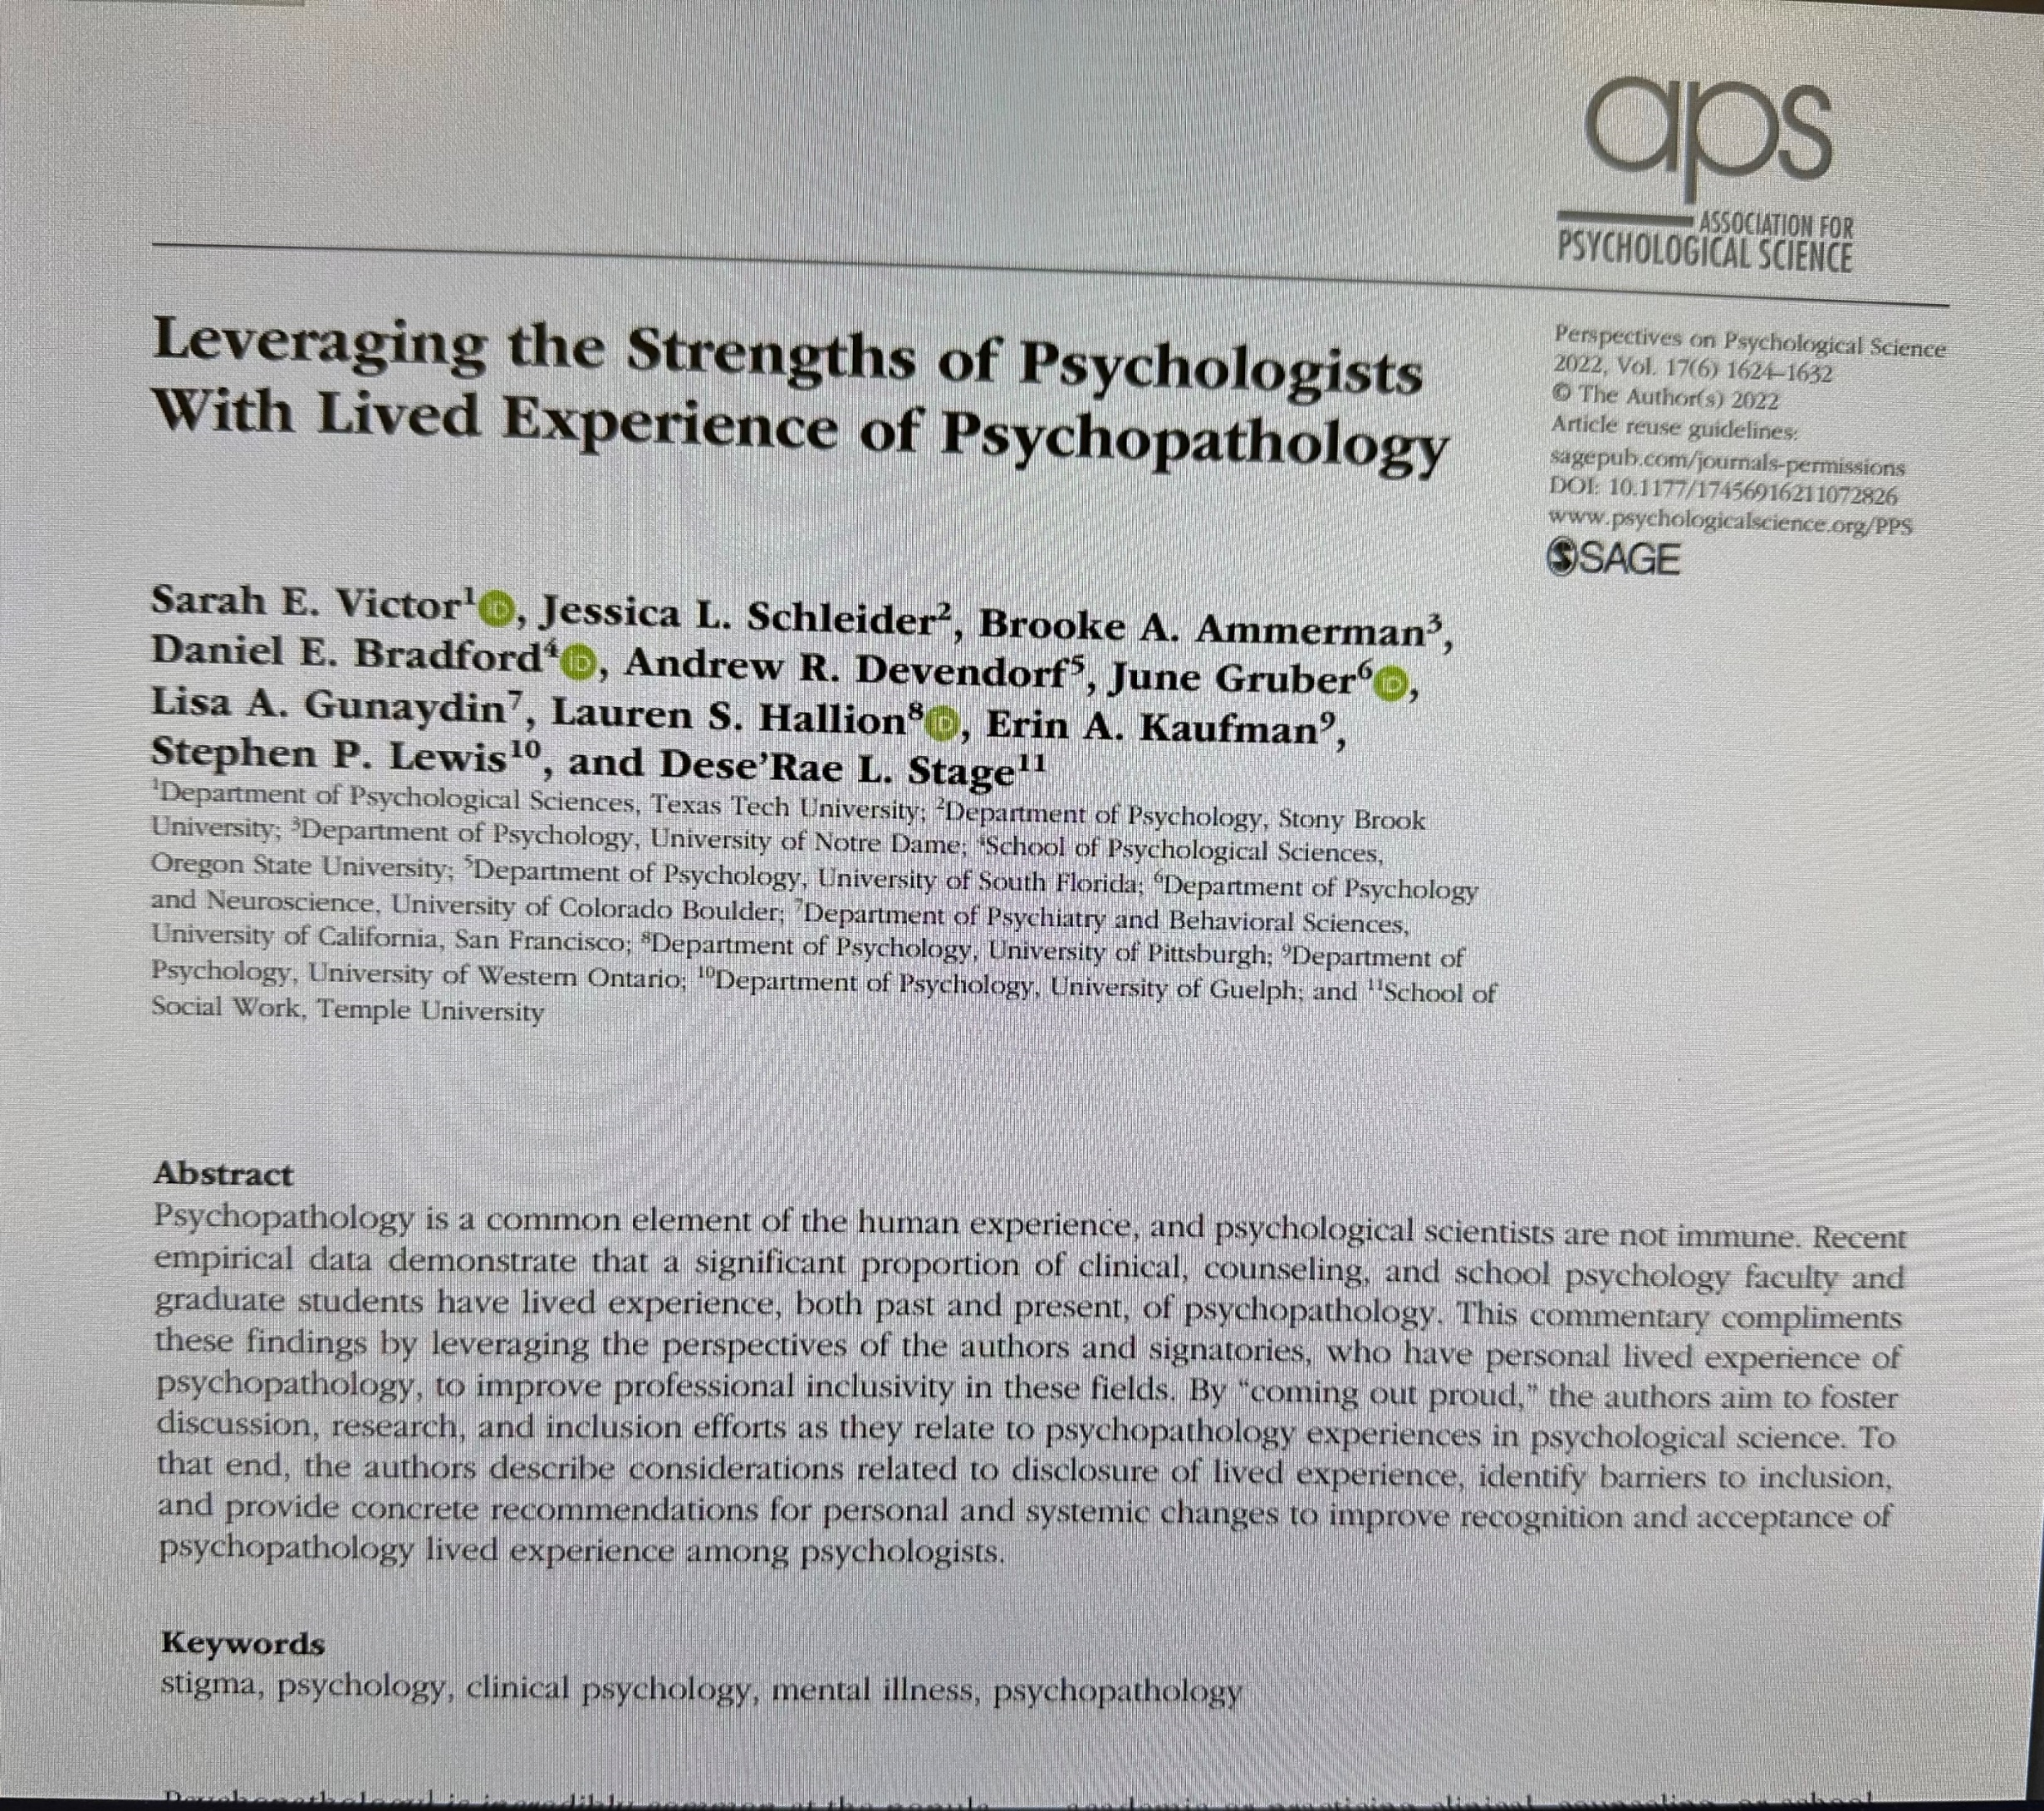
As of December 2022, 81 psychologists had signed the list of signatories (75 named)
Notes:
And in another article by Victor and colleagues, they spoke directly to psychologists’ lived experiences of psychopathology, demonstrating that faculty are now willingly telling others about their own mental health problems. This used to be taboo. Now it further demonstrates the prevalence of mental health problems among faculty.
_________________________
Total Signatories as of December 2022: 75 named, 6 anonymous, 81 total

Slide 12
Rates of burnout are high
High rates of impairing stress and burnout among graduate students and faculty (El-Ghoury, et al., 2012; McCormac et al., 2018; Rummel, 2015; SAMHSA, 2022)
BIPOC and LGBTQ+ trainees may be particularly at risk (Basma et al., 2021)
Notes:
Not only are rates of mental health problems high, rates of burnout are high too. Data show that… (READ SLIDE)

Slide 13
CUDCP Trainee Burnout Study Led by Melissa Hunt N = 1189
Modal hours worked weekly = 60 (range 20-100)
Trainees reported:
High levels of time pressure
Being unable to get enough sleep, exercise, relaxation time, and time with family and friends
High degree of emotional exhaustion
Even if programs talk about and encourage self-care, most trainees disagreed with this statement:
“In my program, the messaging about self-care, work-life balance, and wellness is consistent with the realities of how it is prioritized.”
But a positive program culture is associated with lower burnout
Notes:
The CUDCP Burnout Task Force, led my Melissa Hunt, and of which I’m a member, conducted a survey of trainees from CUDCP programs, and here’s some of what was found… (READ SLIDE)
NOTE: for “In my program…” SAY – so faculty are perceived as are talking the talk, but not walking the walk.
____________________________
Burnout Survey Task Force
Surveyed all CUDCP member programs
1189 Trainees provided at least some data.
Demographics
82% cis-women, 12.4% cis-men, 5% GQ or NB
65% W, 11% H, 6% B, 5% EA, 5% SA, 8% all other ethnicities represented (e.g. PI, NA, Middle Eastern/MENA, SEA, Multiracial)
Age: M = 27.5, SD = 3.4
Modal hours worked weekly = 60 (range 20-100)
Trainees reported:
High levels of time pressure
Being unable to get enough sleep, exercise, relaxation time, and time with family and friends
High degree of emotional exhaustion
Even if programs talk about and encourage self-care, most trainees disagreed with this statement:
“In my program, the messaging about self-care, work-life balance, and wellness is consistent with the realities of how it is prioritized.”
But a positive program culture is associated with lower burnout.

Slide 14
What are we doing to ourselves and our trainees?
Burnout is an ethical issue (APA Ethics Code 2.06)
Self-care is a professional competency
But it is NOT about the self – it is about the SYSTEM
and the demands it places on everyone
Notes:
What are we doing to ourselves and our trainees?
Burnout is an ethical issue because it can lead to impaired functioning and can affect patient well-being, so managing burnout is an ethical obligation.
Self-care – which people promote to help with burnout - also is considered a professional competency – thought it’s framed as an individual competency. This is important because really, it’s NOT about the self, it’s about the SYSTEM and the demands it places on everyone. In particular, our systemic goals of productivity.
“In my day,” the goal of productivity was so normative we didn’t even question it; working as many hours as possible was considered a badge of honor; it was built implicitly into a system that we never even thought to question; now we’re seeing more clearly its impact
Furthermore, the outcome of our extreme focus on productivity – i.e., the proliferation of articles, and journals in which to publish them, just allows people to increase their numbers, but not necessarily their impact; which brings us back to the issue of clinical science not moving the needle on public health
__________________________
APA Ethics Code 2.06
a) Psychologists refrain from initiating an activity when they know or should know that there is a substantial likelihood that their personal problems will prevent them from performing their work-related activities in a competent manner.
(b) When psychologists become aware of personal problems that may interfere with their performing work related duties adequately, they take appropriate measures, such as obtaining professional consultation or assistance, and determine whether they should limit, suspend, or terminate their work-related duties.
Because burnout is a risk for impaired performance, self-care has been identified by APA a foundational profession wide competency (PWC) that we are supposed to be both training and evaluating.
Self-care is being framed as an individual competency that must be taught, learned and practiced.
The larger issue is really the systemic demands that are being placed on everyone in our field, including our trainees.
Even if you try to promote a “culture of self-care,” trainees get the implicit (and sometimes explicit) message from supervisors and clinic directors and mentors and professors and internships and funding agencies that they must maintain astonishing levels of productivity across multiple roles and responsibilities to be successful. (Read journals in bed!)
We need systemic solutions!”

Slide 15
Training from a DEI perspective
Notes:
Finally, regarding out last topic - In clinical science training programs, clinical and research training are integrated, with the idea that this integration strengthens our knowledge base, approach, and training programs as a whole; this is in line with one of the key principles of clinical science – the true integration of science and practice

Slide 16
Clinical
Science
Assumption:
DEI
DEI &
Clinical
Science
Reality:
Notes:
DEI, on the other hand, has typically been siloed into its own separate, peripheral topic, championed by a small group of individuals, and perceived in many ways to be at odds with evidence based practice and rigorous research - as if DEI and clinical science were not compatible
Indeed, many clinical science training programs have not systematically integrated training from a DEI perspective, and even those that have done so have still been training in the context of larger structural systems that work against DEI
Fortunately, there has been lots of interest in changing this, and yet it’s not clear how to best do this
These is not likely to be one “right” way; however, we are seeing numerous organizations and scholars leading discussion on this, creating resources, and making calls for action; we’ll highlight examples of these more formally at the end of our talk today
The question for clinical science training programs is how do they want to utilize and incorporate these into their program in a way that – unlike the past – now centers and uses a DEI perspective as a guiding principle; in a way that makes clear that DEI and clinical science are compatible

Slide 17
Dilemmas
Flexibility vs. accountability
How do we square the calls for required change and accountability with our clinical science training goals of flexibility?
Apparent flexibility vs. potential rigidity
How might the clinical science approach blind us?
Notes:
There are a number of dilemmas that we will have to tackle as we do so
Dilemma of flexibility vs. accountability
How do we square the calls for required change and accountability with our clinical science training goals of flexibility?
Dilemma of apparent flexibility vs. potential rigidity
How might the clinical science approach blind us?
For example, there is a growing recognition that in many instances, particularly with regard to evidence-based treatments, we have failed to consider relevant stakeholders. We have failed to reach relevant communities. We have failed to see outside our own perspectives on what is valuable science, and we have failed to know how to bring clinical science to anyone but other clinical scientists. We need to be mindful of our own assumptions and rigidities and work towards our ideal of flexibility.

Slide 18
We can and should make fundamental changes to improve in all of these four interrelated domains
Notes:
As we continue our presentation today, we see it as our job to inspire ways we can and should make fundamental changes to improve in all of these four interrelated domains.
I’ll now turn things over to Jaisal.

Slide 19
DEI in Clinical Science: A Student Perspective
Notes:
Intro: 4th year clinical science doctoral student at WashU. I was a member of the Academy’s racial justice task force and have done additional work on DEI in clinical science. For example, I’m one of the co-founders and co-leaders of DiSSECT (which stands for Dismantling Systemic Shortcomings in Education and Clinical Training), which is a national student-led organization that aims to develop and disseminate resources dedicated to advancing DEI in clinical science and related training programs. I’m excited about the Academy’s focus on bringing DEI out of the periphery and to the center of training, here to offer a student’s perspective

Slide 20
Students in Clinical Science
Student experience in clinical science programs
Goals to improve upon the current shortcomings (e.g., increase access to quality care)
Student efforts for advancement of DEI in clinical science
Notes:
As we all know, students go to incredibly great lengths and make a number of sacrifices to get into clinical science programs.
And our desire to join these programs and become clinical scientists stems, in large part, from goals to contribute to improving upon some of the sobering data that Joanne just showed us- to disrupt the accelerating mental health crisis, reduce disparities, and improve access to quality care, especially for historically harmed and underserved groups.
Because of this, despite already extensive hours involved in being a clinical science graduate student, a number of students often take additional time and energy to contribute to efforts to make psychological science more socially responsive.

Slide 21
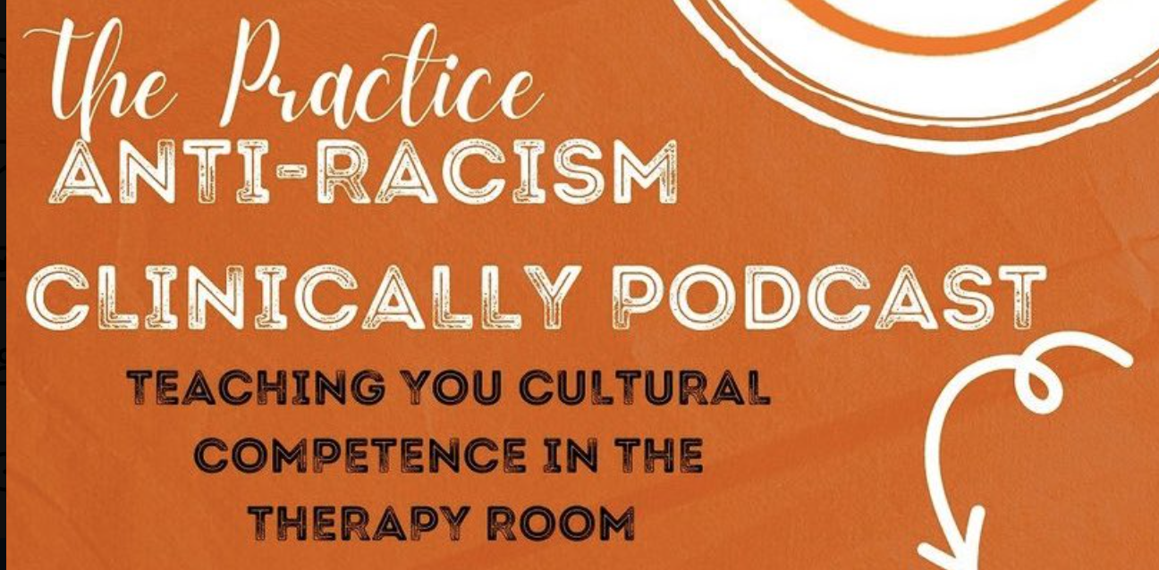
Student Efforts
Notes:
Here are just a few examples of some of the student efforts and groups. Many of these efforts have resulted in measures, papers, and calls to action with the goals to disseminate information about how advance diversity, equity, and inclusion in our programs and our science.

Slide 22
Trajectory for Student DEI Efforts
Summer of 2020: inspired big pushes for DEI advancement
Barrier: perceived disconnect between clinical science and DEI
→ slowed over time
Clinical Science
DEI
Notes:
A huge proporation of this wave of student efforts began in the summer of 2020- (after the murder of George Floyd) we had this racial reckoning; people were angry and inspired to push for the changes they wanted to see in our systems. All the efforts and groups that I’ve outlined started around that time or at least stem from groups that started then. And over time, the momentum and progress toward these student efforts has slowed and student participation in many of these initiatives have decreased.
Ultimately, spark from that initial social movement has dwindled the pressure to progress rapidly in our work as clinical scientists has persisted. And a lot of this slowing seems to stem from this perception that our goals towards progressing as clinical scientists are distinct from those towards advancing diversity equity and inclusion in this field.
So let's explore that a little bit.

Slide 23
Clinical Science as defined per Academy Website
“a psychological science directed at the promotion of adaptive functioning; at the assessment, understanding, amelioration, and prevention of human problems in behavior, affect, cognition or health; and at the application of knowledge in ways consistent with scientific evidence”
Notes:
I want to take a step back and look at the definition of clinical science per the academy website; *pause*; it really speaks to an integration of multiple parts that draws a lot of students to this model of clinical science; from understanding to application; this bidirectional relationship between research and practice. We understand that training is not about wearing a research hat on Monday and a clinical hat on Tuesday, but bringing these pieces together to make data-informed decisions and bring empiricism and skepticism to our science and care.

Slide 24
Clinical Science and DEI
Examining the literature and considering gaps and limitations is core to the way we advance our knowledge as clinical scientists
Critical to do so from the lens of DEI as well
Integration of DEI into our framework aligns with our goals as clinical scientists
Clinical Science
DEI
Notes:
So much of what we do as clinical scientists is build upon our understanding by considering gaps and limitations in the literature and in the state of our current evidence. We think about what may have been overlooked and what we can do to improve upon what’s been done so far.
So examining how factors related to DEI may influence our data, considering what could be updated and improved upon, and using this information to continue to advance our evidence and scientific practice is inherently core to our practice of clinical science.
Ultimately integrating DEI into our clinical science framework, rather than considering it to be at the periphery, is an integral part of our goals as clinical scientists and only serves to advance and improve our clinical science. You’ll see this as a key take home point throughout our remarks. And this idea is also part of the reason for these pushes from students in our program who are drawn to this focus on integrating various pieces that is core to our model of clinical science.

Slide 25
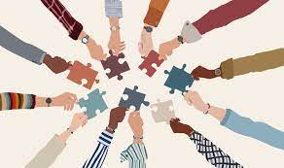
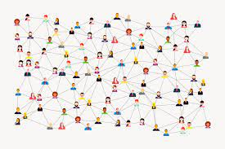
Clinical Science from a DEI Lens
Notes:
Considering clinical science through a DEI lens only serves to improve our clinical science. It involves not one week of a course being devoted to race but the full set of coursework being considered and taught through a critical race lens; not involvement by just the few professors and students willing to take additional time, but by the entire faculty and student body, not constructing and disseminating knowledge just within our academic circles but beyond, not just consideration and implementation of these issues one task force but by the whole academy and whole field

Slide 26
What are the goals of psychological clinical science?
Notes:
I’ll start with the goals of psychological clinical science

Slide 27
Public Health Triangle
Intensive
Targeted
Universal
Notes:
Historically, mental health science and care have focused on the top of the public health triangle with a model focused on reducing symptoms and improving daily functioning for patients with clinically significant impairment. Accordingly, mental health is defined more by absence of illness than by wellness, contentment, or life satisfaction.

Slide 28
Clinical Science Health Triangle
Intensive
Targeted
Universal
Notes:
Minimal investment in mental health promotion at the bottom of the triangle contributes to persistently high and accelerating rates of mental health distress at the top. The result is an inverted triangle yielding significant human and monetary costs associated with illness and intensive care. The inverted triangle is both inefficient and unsustainable.

Slide 29
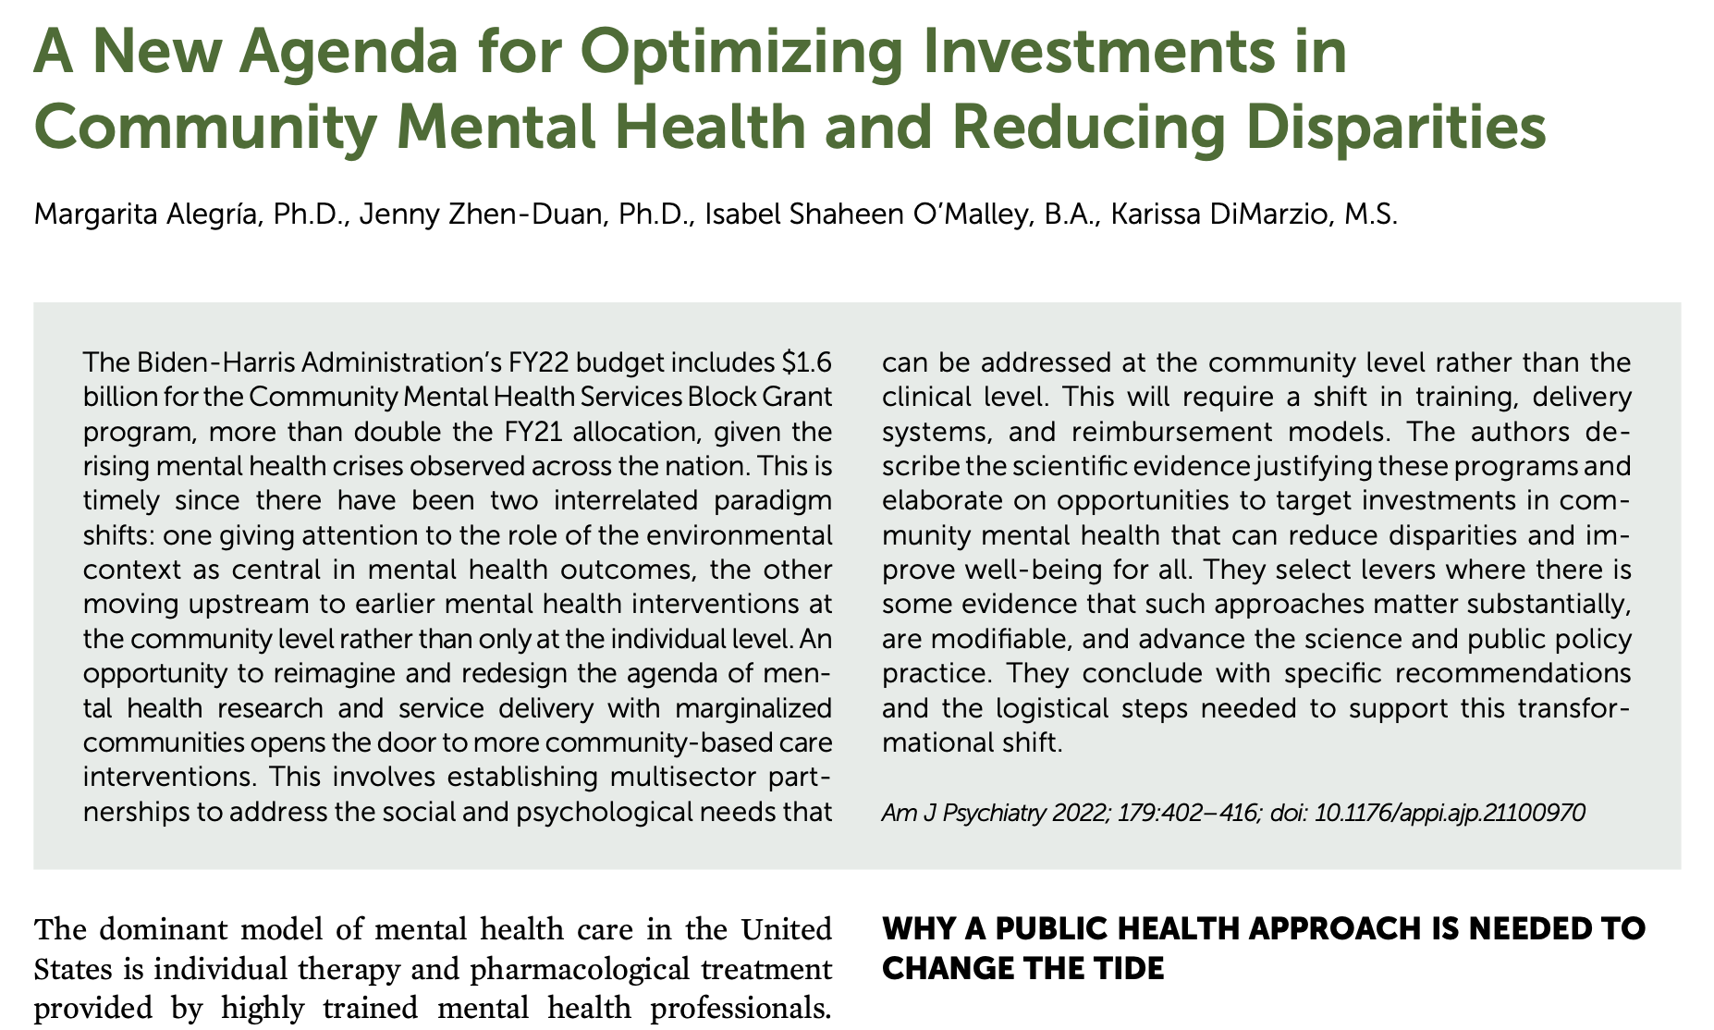
“Why a public health approach is needed to change the tide”
Notes:
What if the goal of psychological clinical science included investment in mental health promoting strengths and spaces at the bottom of the triangle where people live, learn, work, play and pray? How would curriculum change?

Slide 30
Notes:
We have a science for that!

Slide 31
How do we assess and treat mental illness?
Notes:
The science compels us to introspect on our current paradigm for defining, assessing and treating mental illness.

Slide 32
PsychopathologyCentered Science
Notes:
Historically, we’ve imposed White and Western conceptualizations of psychopathology that ignore or minimize cultural histories and values, historical traumas, ongoing marginalization and oppression. And we’ve designed hundreds of treatment manuals through a mostly narrow and White lens of power and privilege that sees need, risk, illness, or pathology, but ignores identities, histories, culture and context.

Slide 33
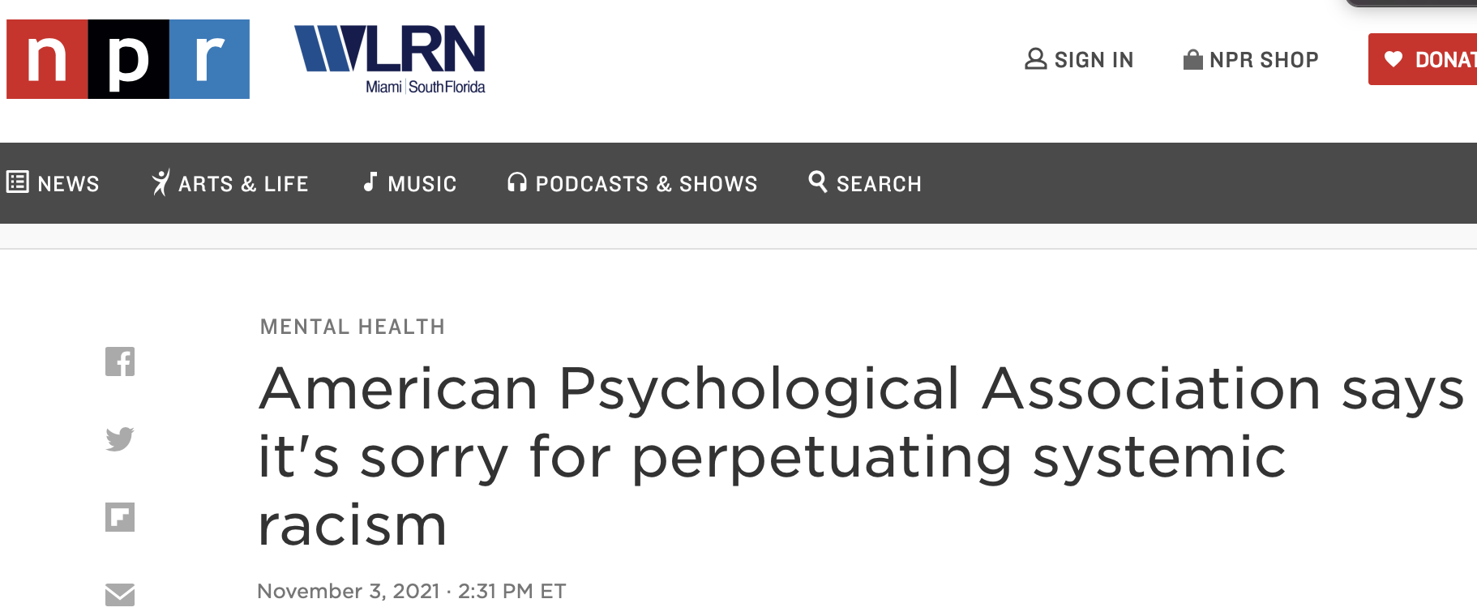
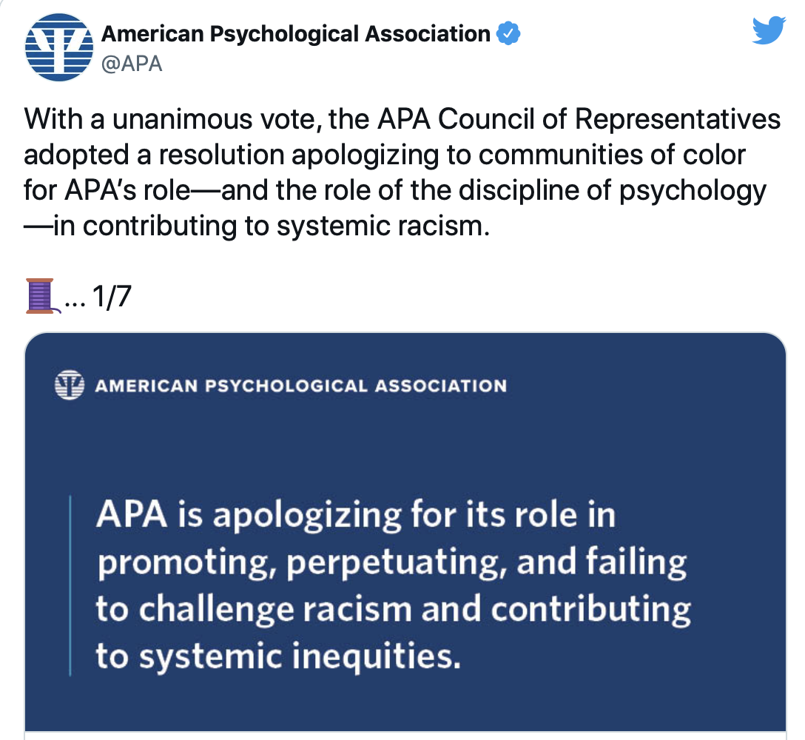
Notes:
But what if mental health suffering itself results, at least in part, from mistakes, biases, and inactions within psychological science?

Slide 34
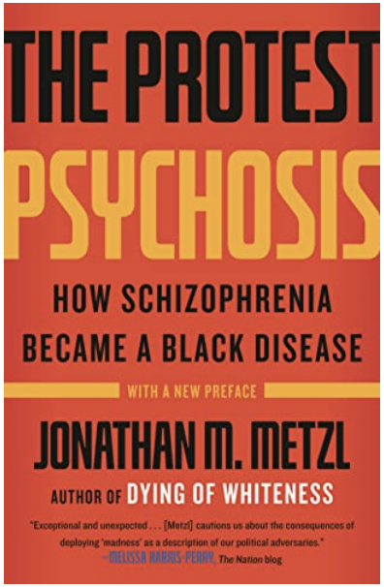
Edition | Year | Parent Category | Diagnosis
DSM-I | 1952 | Personality disorders, Sociopathic personality disturbance, Sexual deviation | Homosexuality
DSM-II | 1968 | Personality disorders, Sexual deviation | Homosexuality
DSM-II sixth printing | 1973 | Personality disorders, Sexual deviation | Sexual orientation disturbance
DSM-III | 1980 | Psychosexual disorders, Other psychosexual disorders | Ego-dystonic homosexuality
DSM-III-R | 1987 | Psychosexual disorders | Sexual disorder not otherwise specified
DSM-IV | 1994 | Sexual and gender identity disorders | Sexual disorder not otherwise specified
DSM-IV-TR | 2000 | Sexual and gender identity disorders | Sexual disorder not otherwise specified
DSM-5 | 2013 | Gender dysphoria | Gender dysphoria in adolescents or adults; Gender dysphoria in children
Notes:
And from biases and harms within psychological clinical science specifically?

Slide 35
Black men account for only 6.5% of the US population, but 40.2% of the US prison population
Notes:
And what if mental health suffering, and disparities in mental health need among marginalized and minoritized communities are both a direct and indirect result of our nation’s historic and ongoing racism

Slide 36
We are persuaded that the future mental health of the nation depends crucially on how, collectively, the costly legacy of poverty is dealt with. (IOM, 2009)
Notes:
chronic and concentrated poverty

Slide 37
Notes:
and systemic injustice in our most fundamental institutions like housing, education, and health care

Slide 38
Call to Action
Notes:
In his 1967 address to APA, Dr. Martin Luther King Jr. cautioned our field about the risks of pathologizing behavior that reflects coping with adversity, the risks of becoming complacent or complicit with unjust systems, of failing to use our role and our voices for change

Slide 39
Call to Action
“Every academic discipline has its technical nomenclature. You who are in the field of psychology have given us a great word. It is the word maladjusted. … But on the other hand, I am sure that we will recognize that there are some things in our society, some things in our world, to which we should never be adjusted. … We must never adjust ourselves to racial discrimination and racial segregation. We must never adjust ourselves to religious bigotry. We must never adjust ourselves to economic conditions that take necessities from the many to give luxuries to the few. We must never adjust ourselves to the madness of militarism, and the self-defeating effects of physical violence.”
Martin Luther King, Jr.
Notes:
He said: “Every academic discipline has its technical nomenclature. You who are in the field of psychology have given us a great word. It is the word maladjusted. … But on the other hand, I am sure that we will recognize that there are some things in our society, some things in our world, to which we should never be adjusted. … We must never adjust ourselves to racial discrimination and racial segregation. We must never adjust ourselves to religious bigotry. We must never adjust ourselves to economic conditions that take necessities from the many to give luxuries to the few. We must never adjust ourselves to the madness of militarism, and the self-defeating effects of physical violence.”

Slide 40
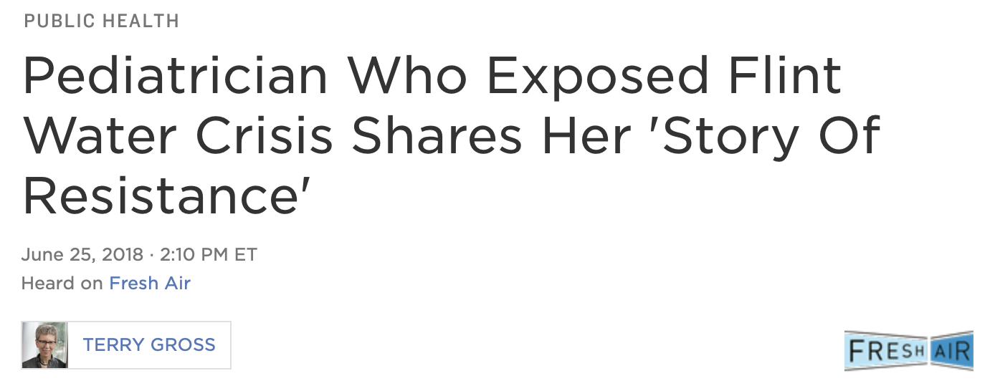
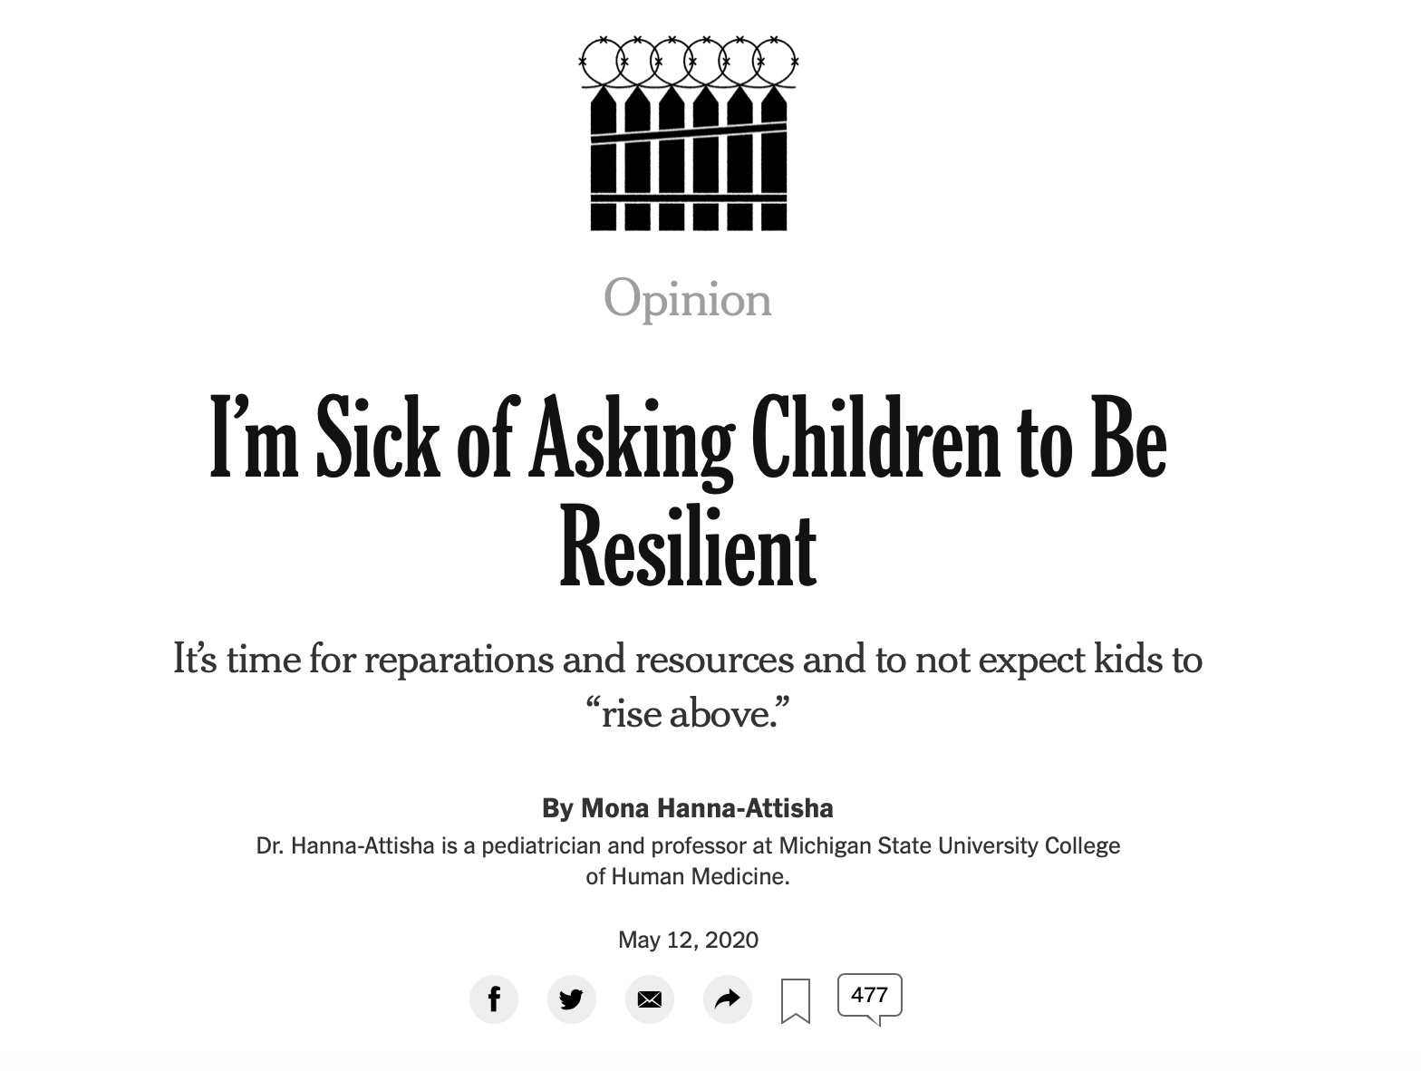
“Surviving life’s hardest blows should not be celebrated — or expected. Recovery and reconciliation require reparations and resources. To expect resilience without justice is simply to indifferently accept the status quo.”
Notes:
Indeed, as someone who’s spent my entire career doing science to QUOTE “mitigate risk and build resilience” with and within historically harmed communities, I’m reevaluating whether my emphasis on coping and resilience makes me complacent or complicit? And how has our notion of “resistance” survived so long to explain why someone may not participate in our research, come to our clinics, or embrace our recommendations. Resistance is how a body protects itself when it perceives threat. It’s also the capacity of a species to survive exposure to a toxic agent. Quite close in fact, to the definition of resilience.

Slide 41
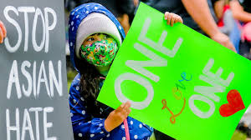
What if clinical science and training were centered on equity, justice, and healing?
Notes:
Today we challenge the workgroup focused on “Moving the Needle for Public Health” to address the 17-year science-to-service gap by considering: What if clinical science and training were fundamentally informed by history and systems of harm to marginalized and minoritized communities and were centered on equity, justice and healing?

Slide 42
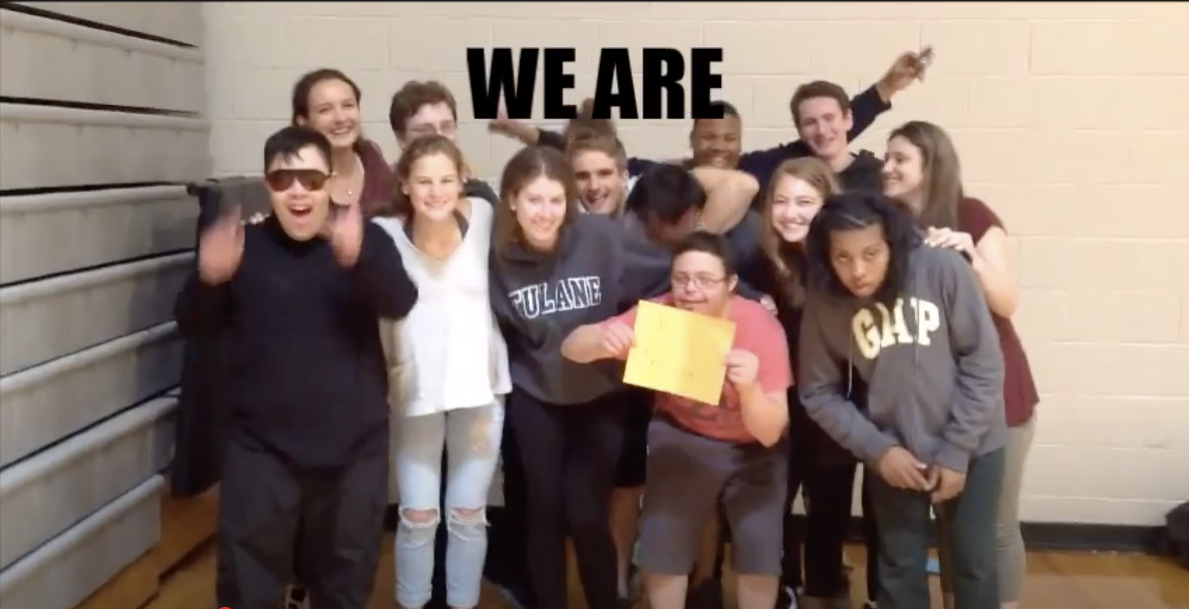
Justice-Centered Clinical Science
Notes:
Conventional models of cultural adaptations ignore within-group heterogeneity; conventional methods exclude individuals with comorbidities or disabilities, or in EEG studies, even individuals with coarse or curly hair; conventional measures reflect White norms; and conventional analyses test moderation by social identities. What if these conventions were replaced by justice centered research methods that engage and lift community voices, embrace inclusion and intersectionality; honor local history and knowledge; assess cultural constructs, strengths, and stressors; leverage cultural norms; and offer a richer, more rigorous, more relevant, and more complete body of knowledge?

Slide 43
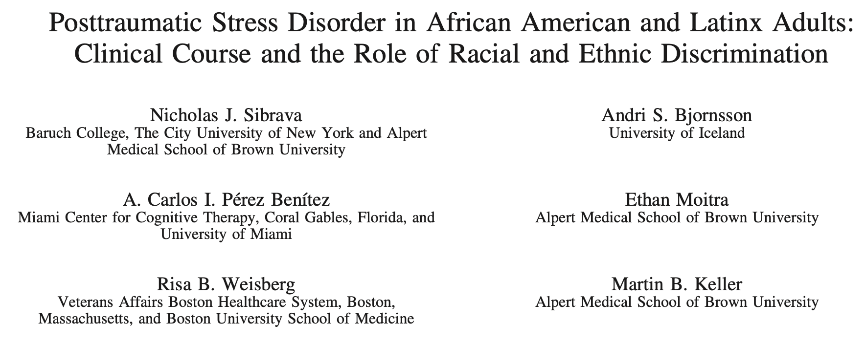
American Psychologist 2019 Special Issue: Racial Trauma: Theory, Research, and Healing
Notes:
We have a science for that!

Slide 44
What is evidence?
Notes:
To move the needle, the first workgroup is tasked with how to make clinical science training accountable to societal needs. This requires a close look at how we define and build evidence.

Slide 45
Well-Established Psychosocial Interventions for Childhood Disorders (Adapted from Chambless, 1996, p. 16, and the Task Force on Promotion & Dissemination of Psychological Procedures, 1995, p. 21; cited in Lonigan et al., 1998)
At least 2 well-conducted group-design studies, by different investigatory teams, showing treatment to be
Superior to pill placebo or alternative tx OR
Equivalent to an established tx in studies with adequate power OR
Large series of single-case design studies that
Use good experimental design AND
Compare tx to another tx AND
Manuals for intervention preferred AND
Sample characteristics clearly specified
Notes:
Historically, randomized controlled efficacy trials have been overdesigned for research contexts and the field’s gold standard for treatment outcome research.

Slide 46
“. . . 10,000 participants in RCTs for major psychiatric disorders since 1986 with only 561 African Americans, 99 Latinos, 11 Asian Americans, and 0 Native Americans . . .” (Miranda et al., 2003)
Notes:
But efficacy trials relying on narrow samples reflecting majority populations, standardized protocols, graduate student providers, symptom outcomes, and intent-to-treat analyses

Slide 47
Evidence fails to represent patients, providers, and settings of community mental health (Weisz et al., 2005)
Notes:
have produced an “evidence” base that largely ignores culture, context, and comorbidity, and severely limits the relevance and return on investment of science for routine care.

Slide 48
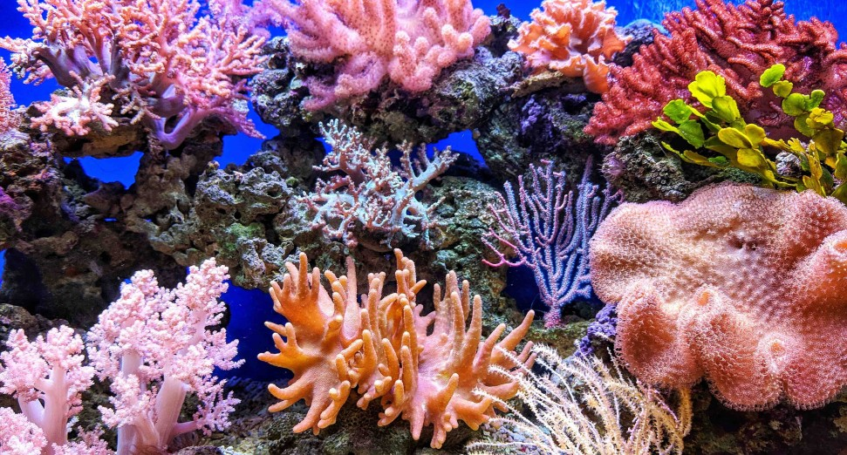
The Coral Reef Crisis
“We can create the most super coral in the world, but if we can’t swamp the system with them, it’s not going to work” Tom Moore, Coral Reef Restoration Lead at the National Oceanic and Atmospheric Administration, 11/22/2019
Notes:
I’m reminded of one of my favorite NPR Science Friday interviews with Tom Moore who said we’ve poured millions into growing coral in laboratories – ultimately to be replanted in the ocean. But then he said ya know, for the longest time we weren’t accounting for so many variables that are gonna determine survival – they considered water temperature, depth and sunlight, but ignored sediment, plankton, ocean acidification, dust storms, pollutants, viruses, algal blooms, and they were left with lab-grown coral that can survive only in just the right conditions - conditions that exist few places in the ocean. We have to grow coral where we want it to thrive and flourish, he said … and he added that doing so will enhance our appreciation for the tremendous resilience of those diverse spaces

Slide 49
What if we expanded our research questions, designs, and methods?
Efficacy: To what extent does treatment reduce symptoms in a lab?
Effectiveness: To what extent does treatment improve functioning in routine care?
Mechanisms: What factors contribute to improved outcomes?
Dissemination Science: How do we move knowledge from here to there most efficiently, at lowest cost, with greatest impact? E.g., Social networks, social capital, social marketing
Implementation Science: How do we influence routine care adoption and sustained use?
E.g., Organizational social context, Common elements, Measurement feedback systems, WISE interventions, Inner context facilitators and barriers, Technology-facilitated and remote care
Notes:
What if we expand our research questions, designs, and methods to account for the architecture, resources, strengths, and fragmentation of community mental health systems

Slide 50
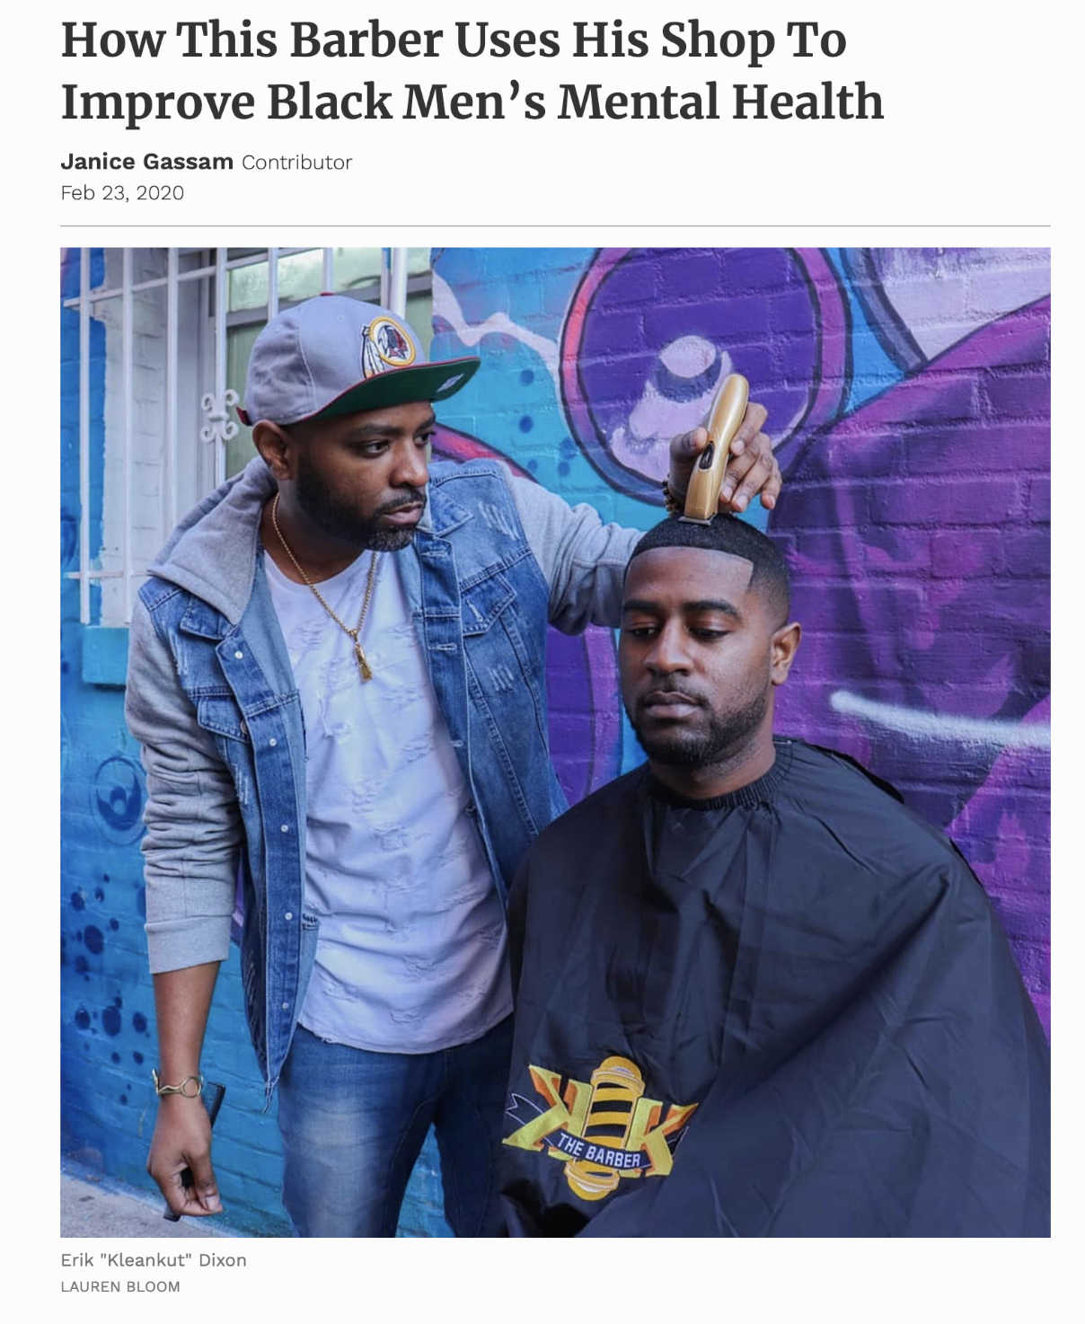
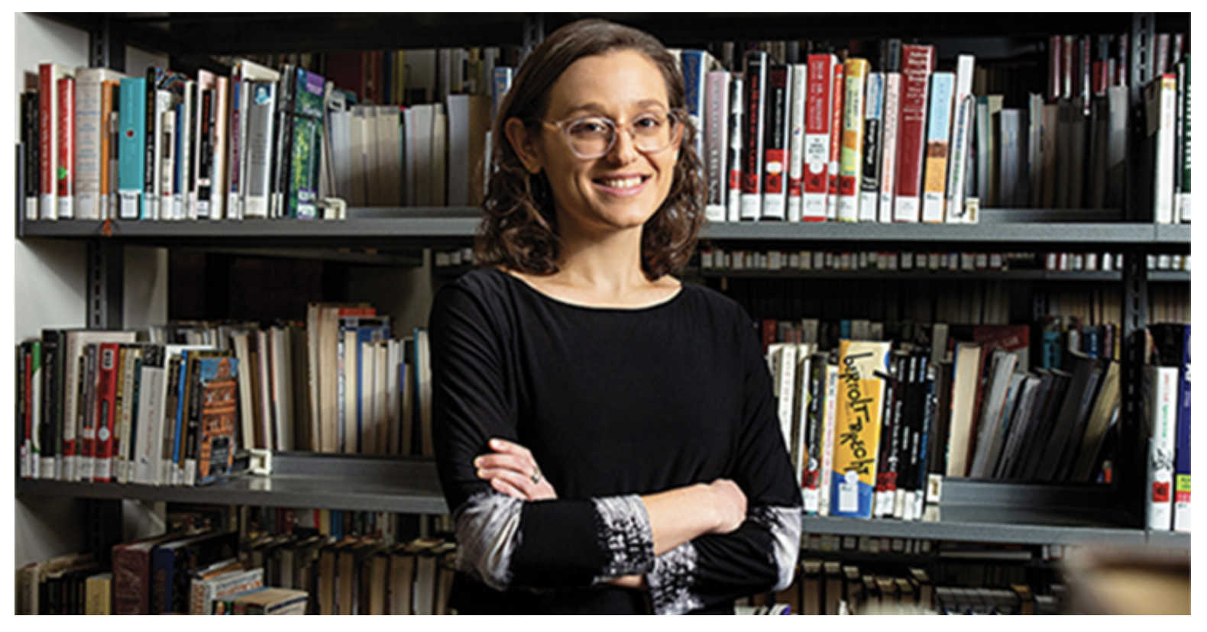
Mental Health Champions
Services Research: How do we achieve an efficient, effective, and equitable model of care for diverse communities?
E.g., Workforce support, Task-shifting, Non-specialty settings, Lay workforces, Funding streams, Outer context and policy
Notes:
and make clinical science racially and historically conscious; and accessible, digestible, and actionable for mental health champions on the frontlines who are meeting the mental health needs in communities where we’ve not gotten it done.

Slide 51
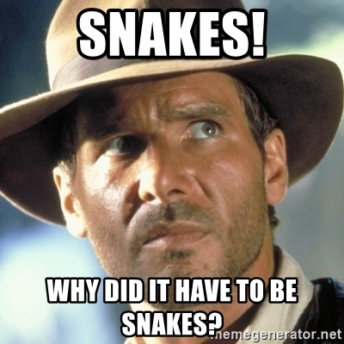
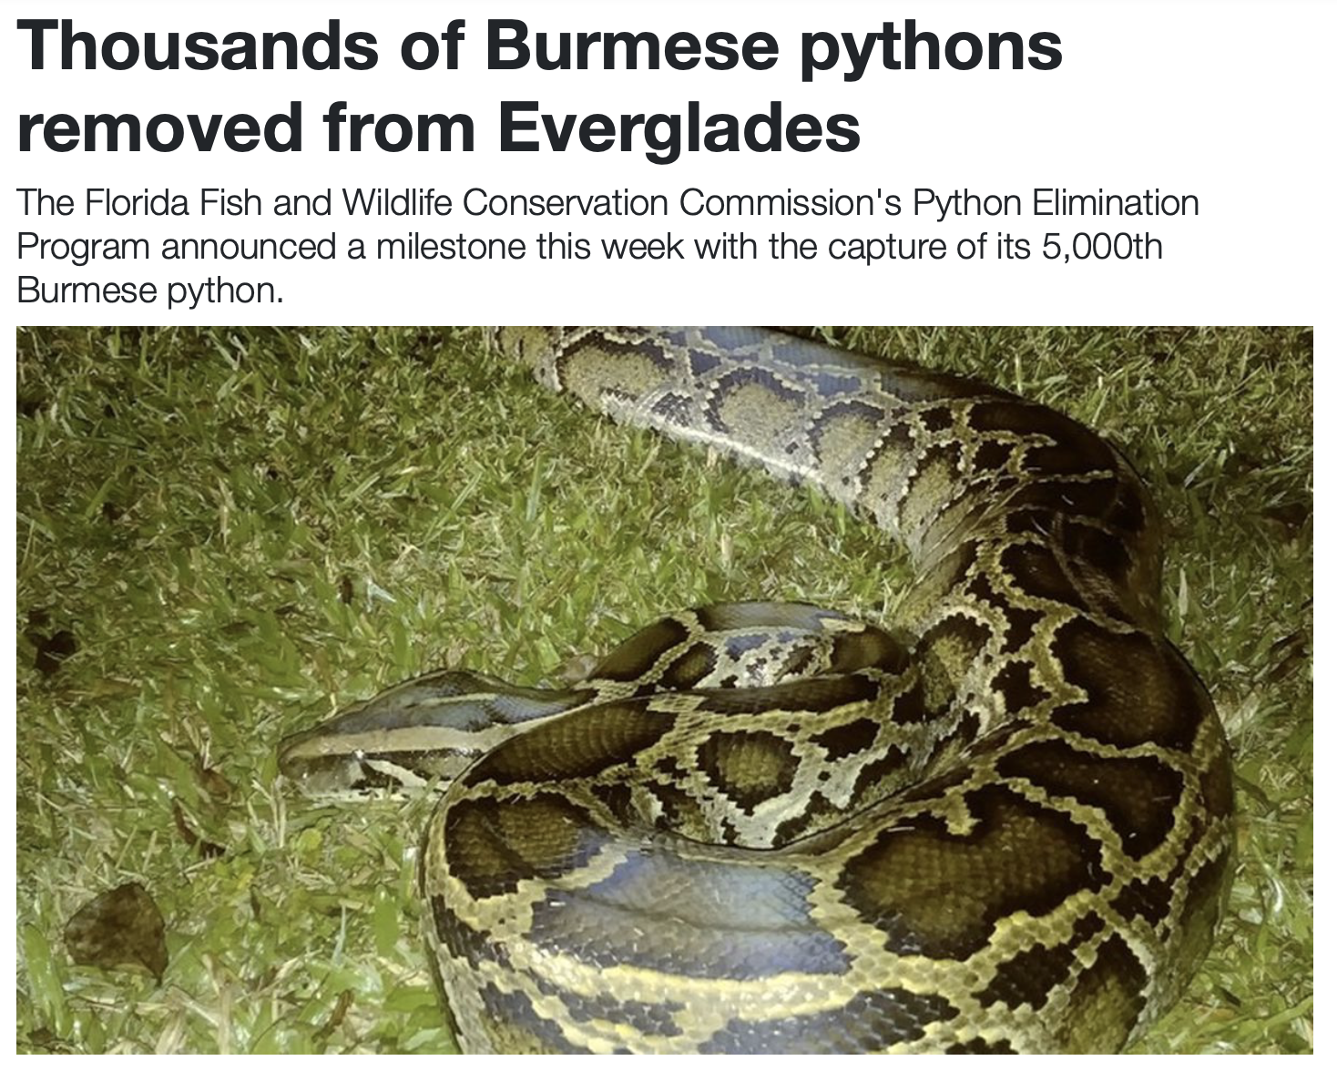
Notes:
Like in my state of Florida, where Python Hunters invite military veterans to join Swamp Apes

Slide 52
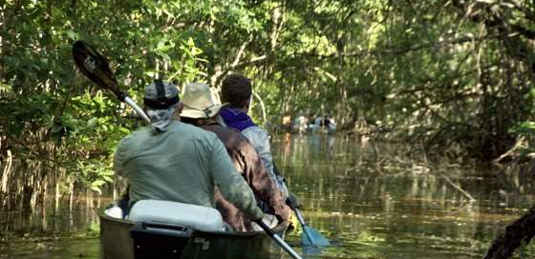
Swamp Apes
Wilderness experiences for veterans
Leverage military specialization
and survival skills; sense of purpose
Opportunities to serve community;
contribute to a mission
Build social support networks
MH support around exposure to triggers
Notes:
Wilderness experiences like these are compelling for veterans because they leverage their skills, offer a sense of purpose and pride reflecting their desire to serve, and facilitate social networks. They also expose veterans to potential triggers, providing opportunity to learn and practice exposure-based skills, which is why collaborators from USF are bringing mental health training, resources and research expertise.

Slide 53
After all, what is the alternative? Unjust clinical science?
Notes:
Today we challenge the workgroup focused on “Training from a DEI perspective” to consider why DEI has been siloed and the danger to science and society of it remaining on the periphery of training. Why DEI has been championed by committees and workgroups, and the risk of students – particularly from under-represented groups – carrying so much of the responsibility and labor to fill holes in the broader science and training landscape. Today we challenge this workgroup to make diversity, equity, and inclusion a centering value for science and training.

Slide 54
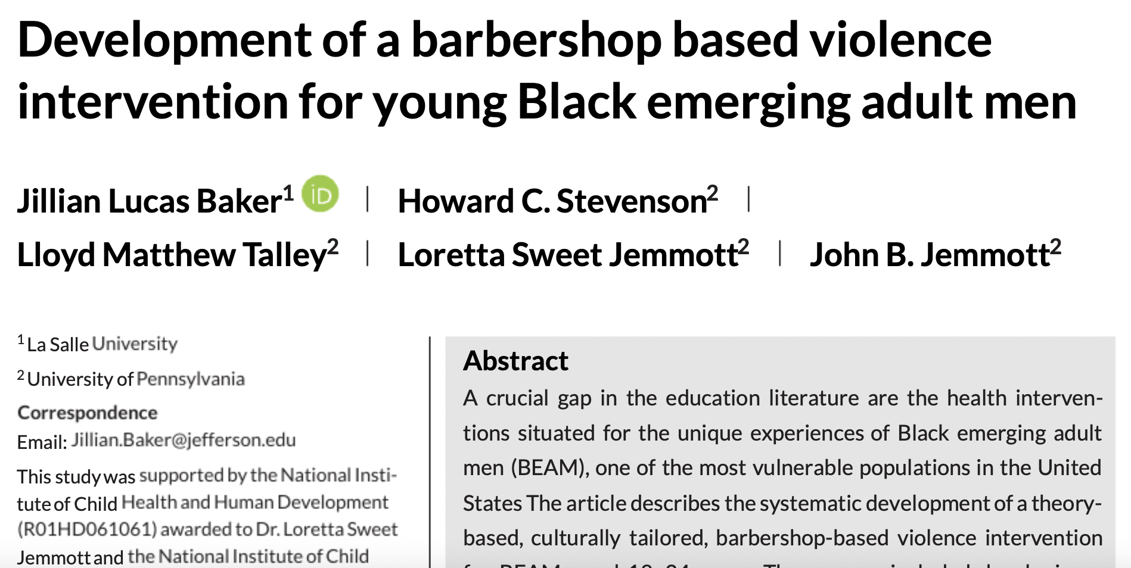
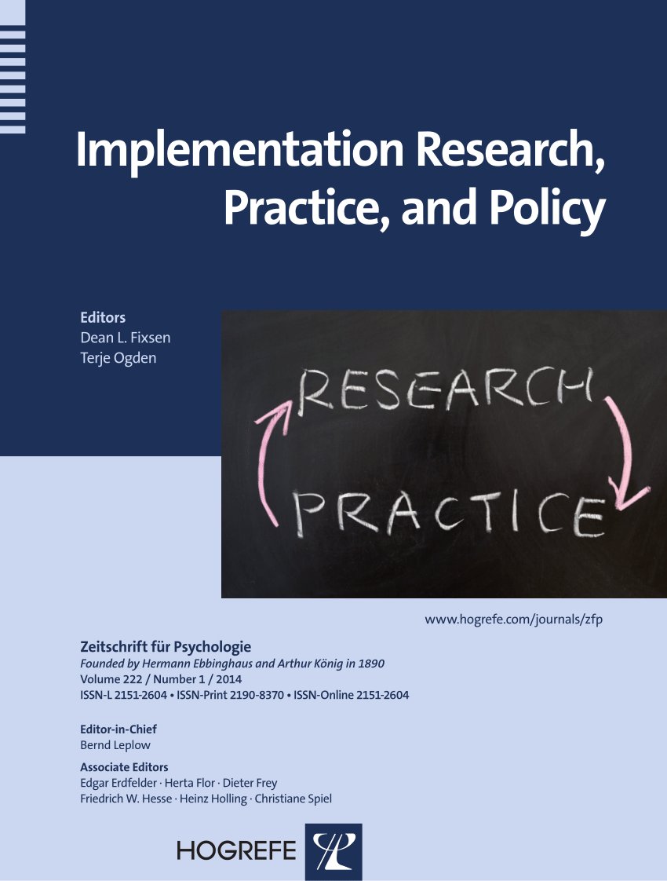
Notes:
And yes, several decades of research can inform how to build a clinical science that is socially just and humbly relevant for the physical and social spaces that are inviting, affirming, healing, and mental health promoting.

Slide 55
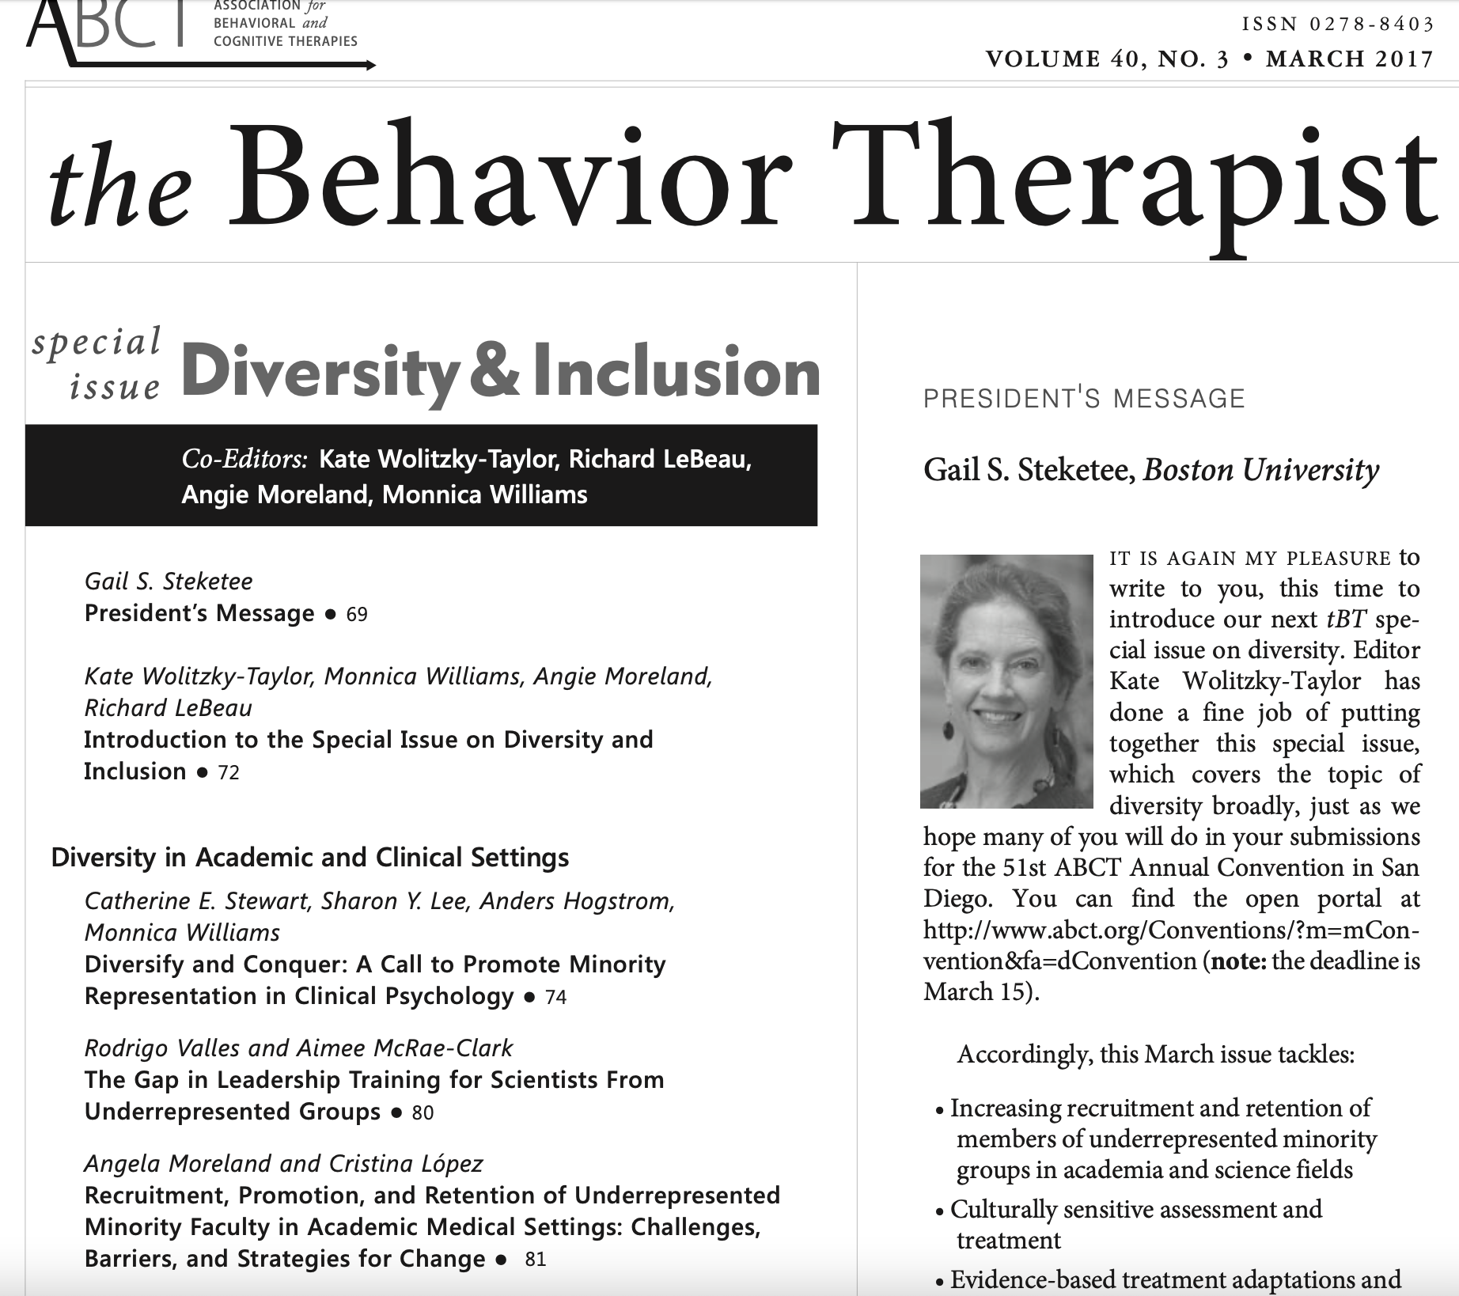
Notes:
And we have models, recommendations, and toolkits for training too.

Slide 56
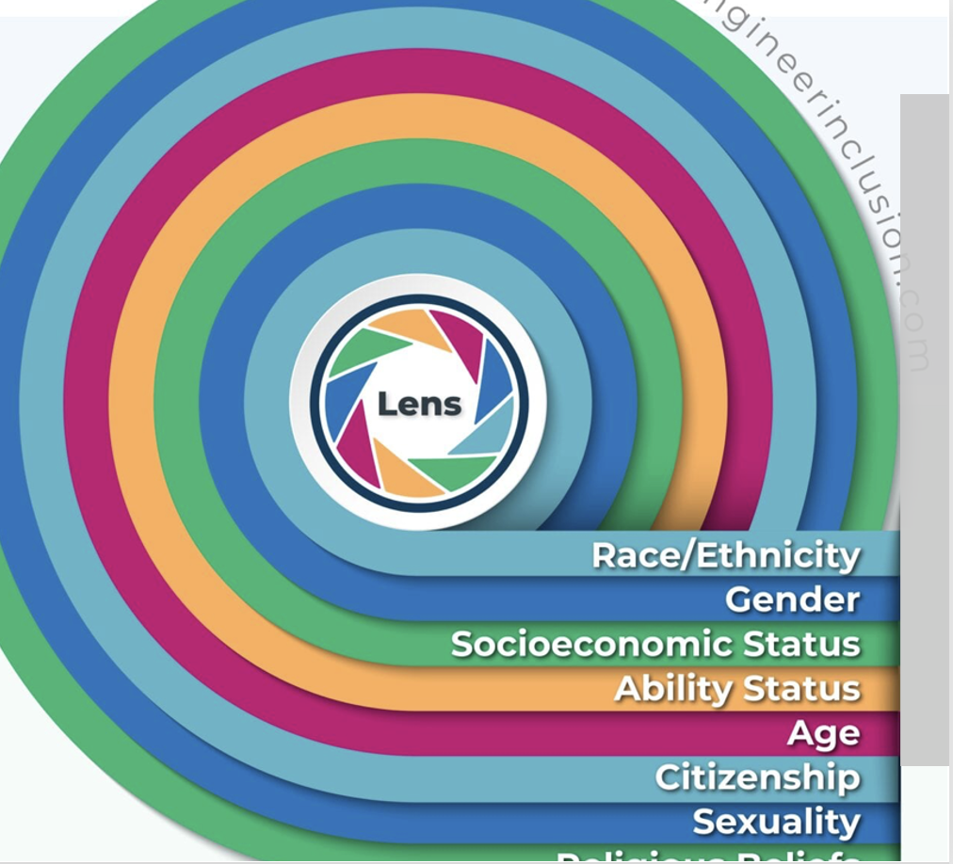
Who should contribute to expanding the evidence base?
Notes:
So, what does this all mean for whose voices should contribute to expanding the evidence base? Historically, we’ve been training a clinical science workforce that lacks representation of marginalized and minoritized communities, reflecting (at least in part) an access and opportunity gap at all stages of education. But diversifying our scientific agenda – diversifying samples, spaces, and services – requires diverse scholars. And diversifying the workforce is not only a moral imperative, but a necessity for building a better clinical science and improving our accountability to societal needs.

Slide 57
Equitable Evaluation of Applicants
the most competitive application process in the entire graduate education system within the United States! A smaller percentage of applicants gain admission to clinical psychology doctoral (Ph.D.) programs than to law school, medical school, or any other type of advanced graduate degree program… (Prinstein, 2017, pp. 28)
Notes:
The second workgroup will tackle “equitable evaluation of applicants” which is a heavy lift given the significant inequities that permeate all levels of education and access to opportunities for achieving the metrics that we’ve conventionally valued. There’s been effort over several years to reduce the value placed on GRE scores

Slide 58
“Admissions is certainly biased because it very reliably produces outcomes that disproportionately admit people who are from backgrounds already represented within the academy and doctoral education.” (Posselt, 2022)
Notes:
But every component of the application package is impacted by privilege, beginning with what college a student attended (which may reflect more cost and distance from home than high school success or aptitude) and volume of undergraduate research experience, which is often unpaid and less feasible for students paying for college with full-or part-time jobs. In this great Inclusivity Spotlight Session during the APS convention last year, a distinguished panel described how the systems we use for outreach, recruitment, and admissions have ‘stacked the deck’ against historically marginalized groups.

Slide 59
“Often people worry about readiness because our programs are set up as sink-or-swim environments, and we assume that a certain set of entry characteristics will reduce the risk that students sink. In this world, the ‘best’ students are the ones who need us the least. It’s time to rewrite the standard scripts about readiness.”
(Posselt, USC)
Notes:
They encouraged us to reconsider what we assume it means for students to be “ready” for graduate school and why we deem those criteria essential. The panel wondered whether “ready” is about skills or experiences that we believe prepare students to move at a certain pace? Or to proceed without a heavy investment of our own training or support? And they wisely suggested we assess our own “readiness” by doing the ”organizational inner work” that prepares us as faculty, mentors, and programs to be student-ready.

Slide 60
Beyond Recruitment
Notes:
Indeed, equitable evaluation and more inclusive admissions means we need programs sincerely ready to nourish the flourishing of diverse students. Programs that help students thrive more than just survive and live rather than put their lives on hold. Curriculum with liberated syllabi; Faculty who understand why students holding underrepresented identities may feel both invisible and hyper-visible. Mentors with whom students feel safe, seen, heard, and valued, and peers that offer strength and sustenance.

Slide 61
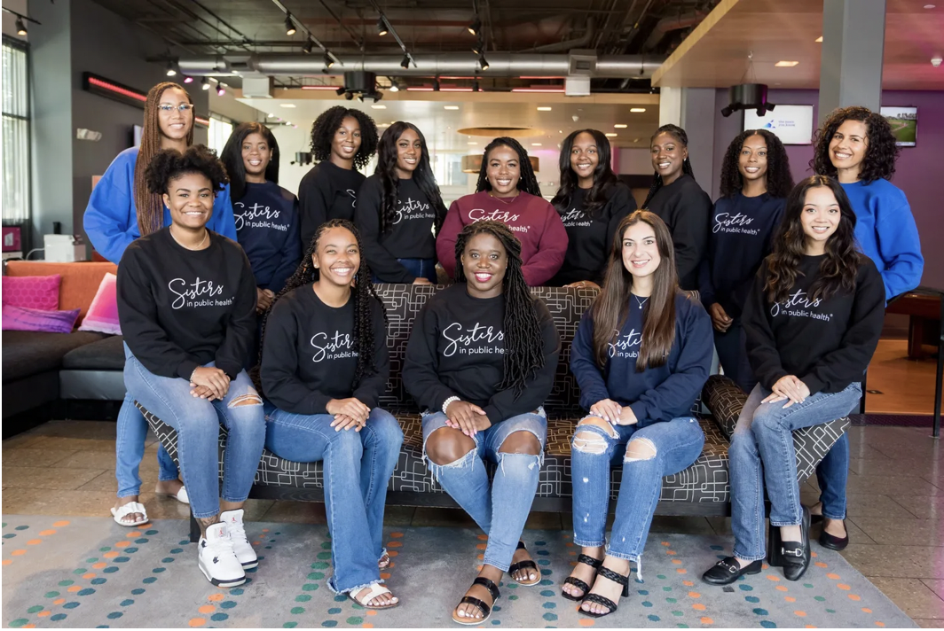
Notes:
Diversifying means we take seriously the empirically-well documented constructs of stereotype threat and imposter syndrome; that we encourage and help students find resources and supports that affirm their identities to mitigate the racial battle fatigue rather than discourage them from spending time with affinity groups, friends and family because we worry these “distractions” may disrupt their “productivity”

Slide 62
Diversifying means putting systems in place that lift students up and say you belong here.
Notes:
Diversifying means putting systems in place within our labs and programs that lift students up and say you belong here.

Slide 63
Notes:
Diversifying means we take seriously that student lives are complicated. Some are moving away from family for the first time, because they afforded college by living at home. Some are caring for children or aging parents. First-gen students are learning the hidden curriculum, norms, and expectations of graduate school. Many are themselves living and learning with disabilities and mental health difficulties, and nearly all students are financially strained.

Slide 64
Notes:
And when exciting life milestones like weddings or babies are celebrated, or when emergent life events like illness, injury, or loss disrupt routines, delay milestones, or extend timelines, valuing diversity means throwing students a lifeline, offering support and reassurance, not watching them drown, judging their agency or absence, questioning their ambition or ability, or leaving them without income or health insurance by urging them to take a leave of absence.

Slide 65
“academia's "hidden curriculum" … could make it easier for people from academic families to navigate the otherwise opaque processes of funding, publishing, professional advancement, and more.”
Notes:
Diversifying means questioning our narrow definitions of success and productivity; recognizing that sometimes the students we celebrate for their high productivity may have arrived at graduate school better prepared or better funded, with academic pedigrees and protected time that accelerate publishing; they may identify with groups more protected from the harmful personal impacts of social injustice locally or nationally; or they may be missing out on sleep, nutrition, exercise or joy in science and life;

Slide 66
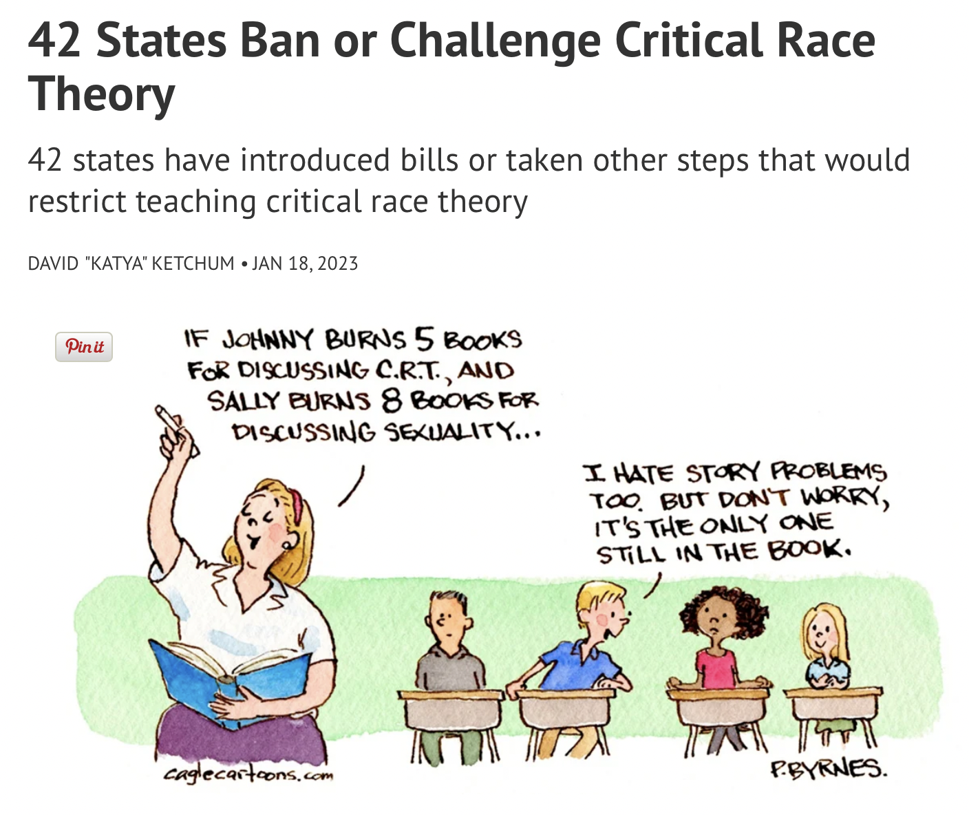
Notes:
Diversifying means recognizing that sometimes students we criticize may hold visible or invisible identities that are relentlessly under attack; or are navigating life events they wish not to disclose for privacy or for fear of being perceived as less capable, less motivated, less dedicated, less resilient, or just less.

Slide 67
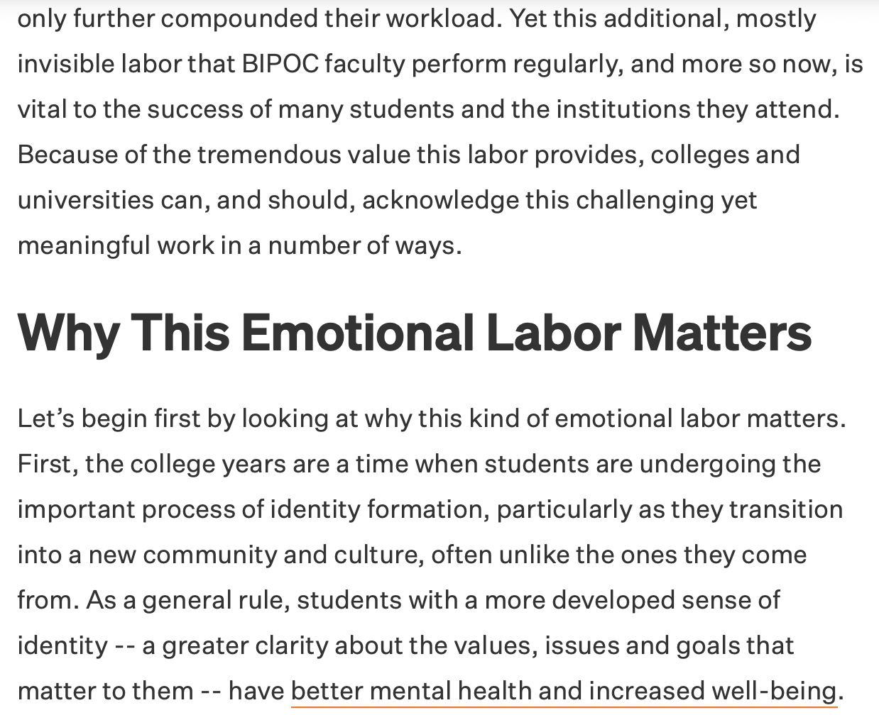
Notes:
Let’s acknowledge too that faculty also report work-related stress, emotional exhaustion, and burnout at alarming rates, and that these too are higher for faculty identifying with groups underrepresented in academia, in part attributable to their disproportionate – but undocumented and unrewarded - invisible and emotional labor.

Slide 68
Notes:
Let’s remember that conventional incentive structures create a “culture of overwork” that puts career advancement goals at odds with going beyond the conventional paradigms; at odds with pursuing authentic time- and labor-intensive community engaged research; at odds with prioritizing civic engagement, action and advocacy; and at odds with prioritizing our own or our students’ health and well-being.

Slide 69
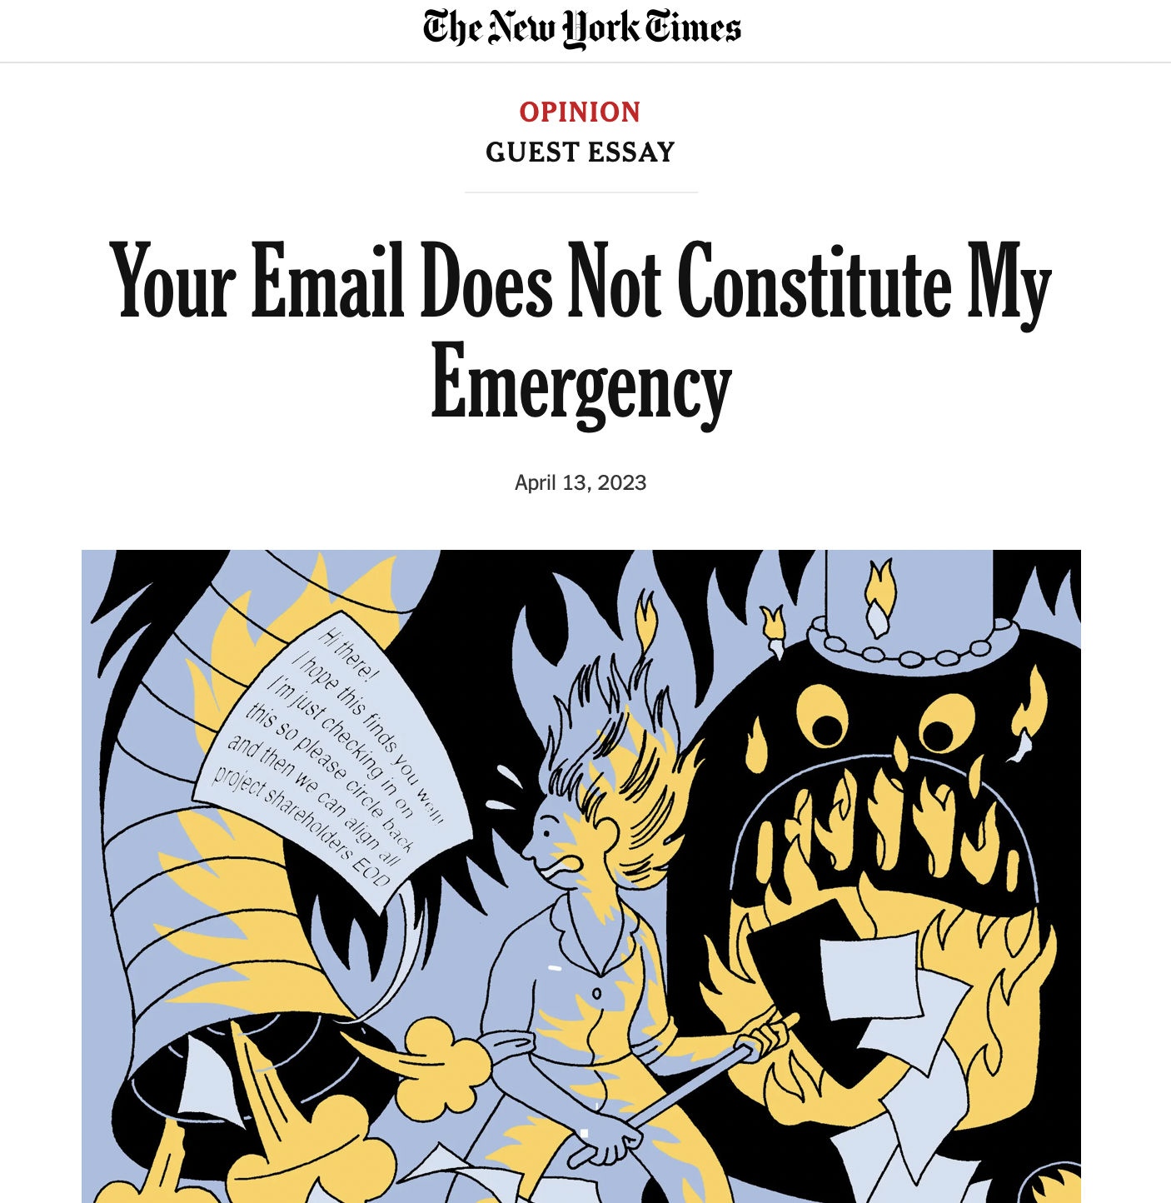
What will it take to bring faculty and student needs into better alignment?
Notes:
What would it would take to bring what’s good for faculty and what’s good for students into closer alignment? In what ways have the last few decades of technological advancement – internet, email, cell phones, laptops, social media – changed how faculty and students work and interact, increased the volume of science to consume and synthesize, and created on-demand expectations for availability that blur the lines between home and work?

Slide 70
How can we achieve synergy among the goals of advancing science, advancing careers, and advancing public health all while valuing, protecting, and promoting our own and our students’ physical and mental health and well-being?
Notes:
Today we challenge the workgroup focused on Reducing Burnout to consider: How we can achieve synergy among the goals of advancing science, advancing careers, and advancing public health all while valuing, protecting, and promoting our own and our students physical and mental health and well-being?

Slide 71
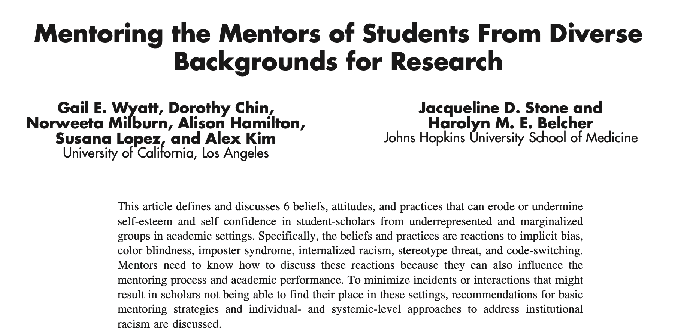
American Journal of Orthopsychiatry May 2019 Special Issue: Mentoring
Notes:
We have a science for this! Because a model of only the strongest will survive is not responsible, it’s not sustainable, and it’s not good for students, faculty, science, or society.

Slide 72
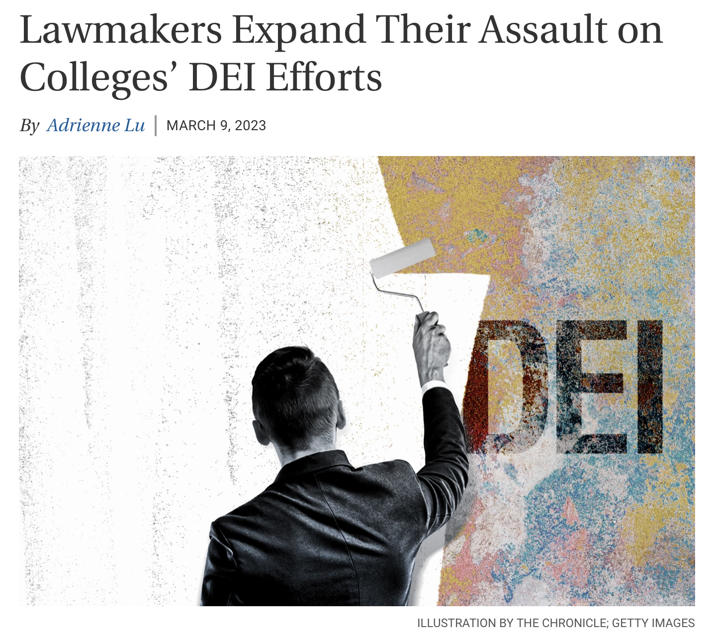
“We are witnessing right now a massive and unabashed assault on voting rights unlike anything we’ve ever seen since the Jim Crow era. This is Jim Crow in new clothes.” (Georgia Democratic Senator Raphael Warnock, maiden floor speech March 2021)
Notes:
As we close, let’s really consider the sociopolitical landscape fueling and accelerating attacks on DEI in public education around the country, my great state of FL leading the way (in fact by giving this talk I’m probably giving them another reason to fire me). Accountability to meet society’s needs also means inserting ourselves and bringing psychological clinical science into these local, state and national conversations; honoring the goals of clinical science and our obligation to the public to protect and promote mental health; and training and incentivizing scholars to conduct policy-conscious and policy-impactful research, and to engage in action, activism, and advocacy.

Slide 73
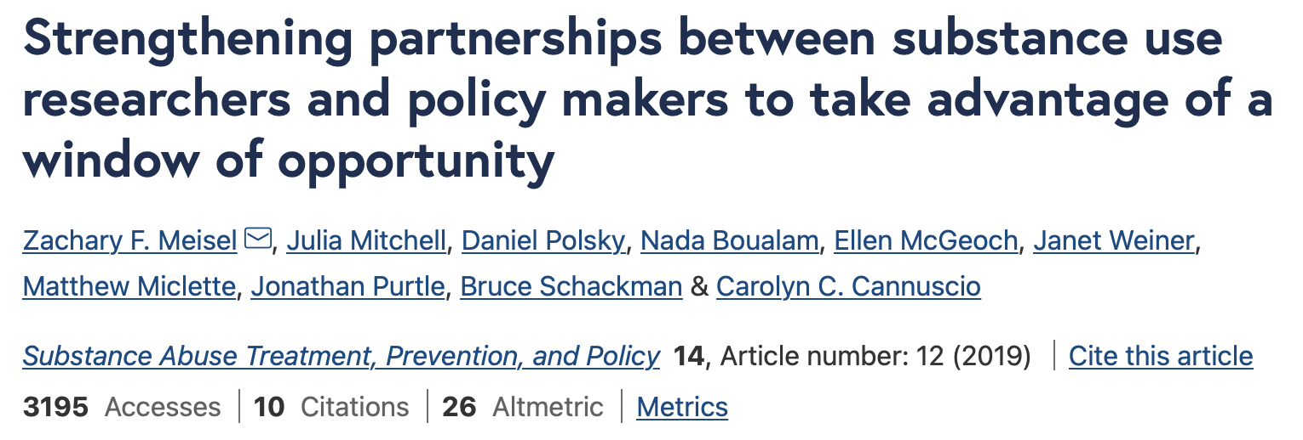
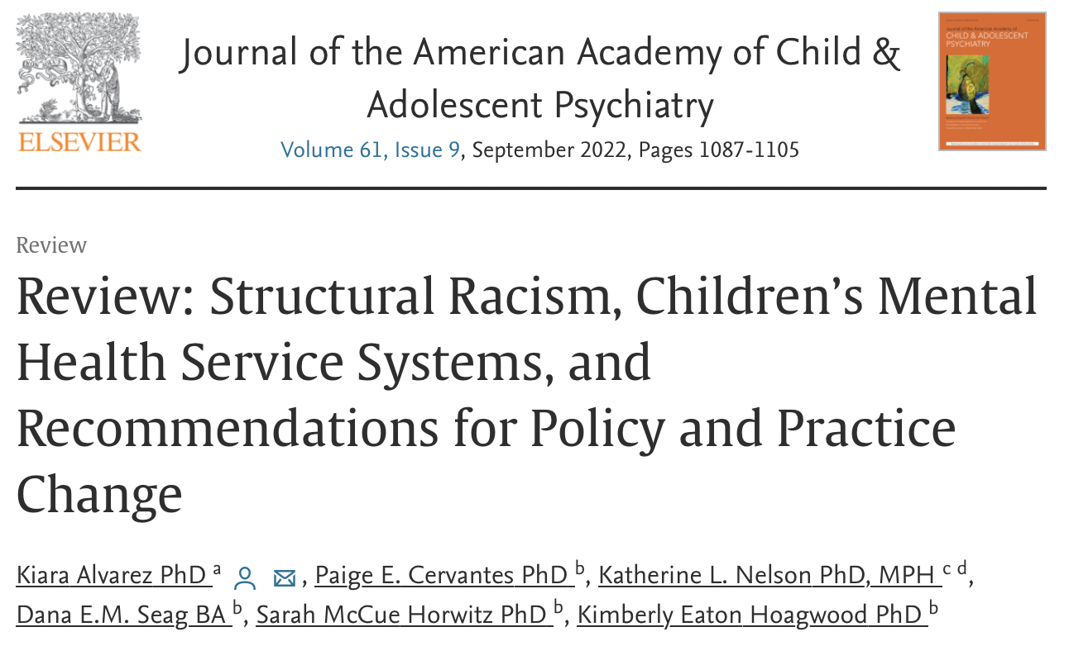
Notes:
And yes, we have a science for this too! Because we can’t ignore the harms happening right now; and the risk of widening disparities that will interfere with equitable, inclusive and affirming education and care.

Slide 74
Notes:
Because silence is not neutral. Silence is not non-partisan. Silence is loud and it is privileged. Silence communicates – to colleagues, to students, and to the public – that we are indifferent and that we are complacent.

Slide 75
“There never seems to be a convenient time for fundamental change”
“We are not so foolish as to expect that everyone will agree with our analysis of the situation or with all of our proposal. If we focus attention on the Academy’s mission and stimulate constructive discussion of how best to achieve this mission, however, then we will have served a worthwhile purpose.”
McFall, Manifesto for a Science of Clinical Psychology, 1991
Notes:
We’ll end with a tribute to Dick McFall … “We are not so foolish as to expect that everyone will agree with our analysis of the situation or with all of our proposal. If we focus attention on the Academy’s mission and stimulate constructive discussion of how best to achieve this mission, however, then we will have served a worthwhile purpose.”

Slide 76
“I always felt that a scientist owes the world only one thing, and that is the truth as he sees it. If the truth contradicts deeply held beliefs, that is too bad. Tact and diplomacy are fine in international relations, in politics, perhaps even in business; in science only one thing matters, and that is the facts.” (Eysenck, Rebel with a Cause, 1997)
Notes:
Agree with us or not – this is not a choice – This. Is. Science.

